Slide 1


Xiaotong Yao’s PhD defense
Dissertation committee
Christina Leslie (chair)
Marcin Imielinski (major sponsor)
Simon Powell
Iman Hajirasouliha

Slide 2
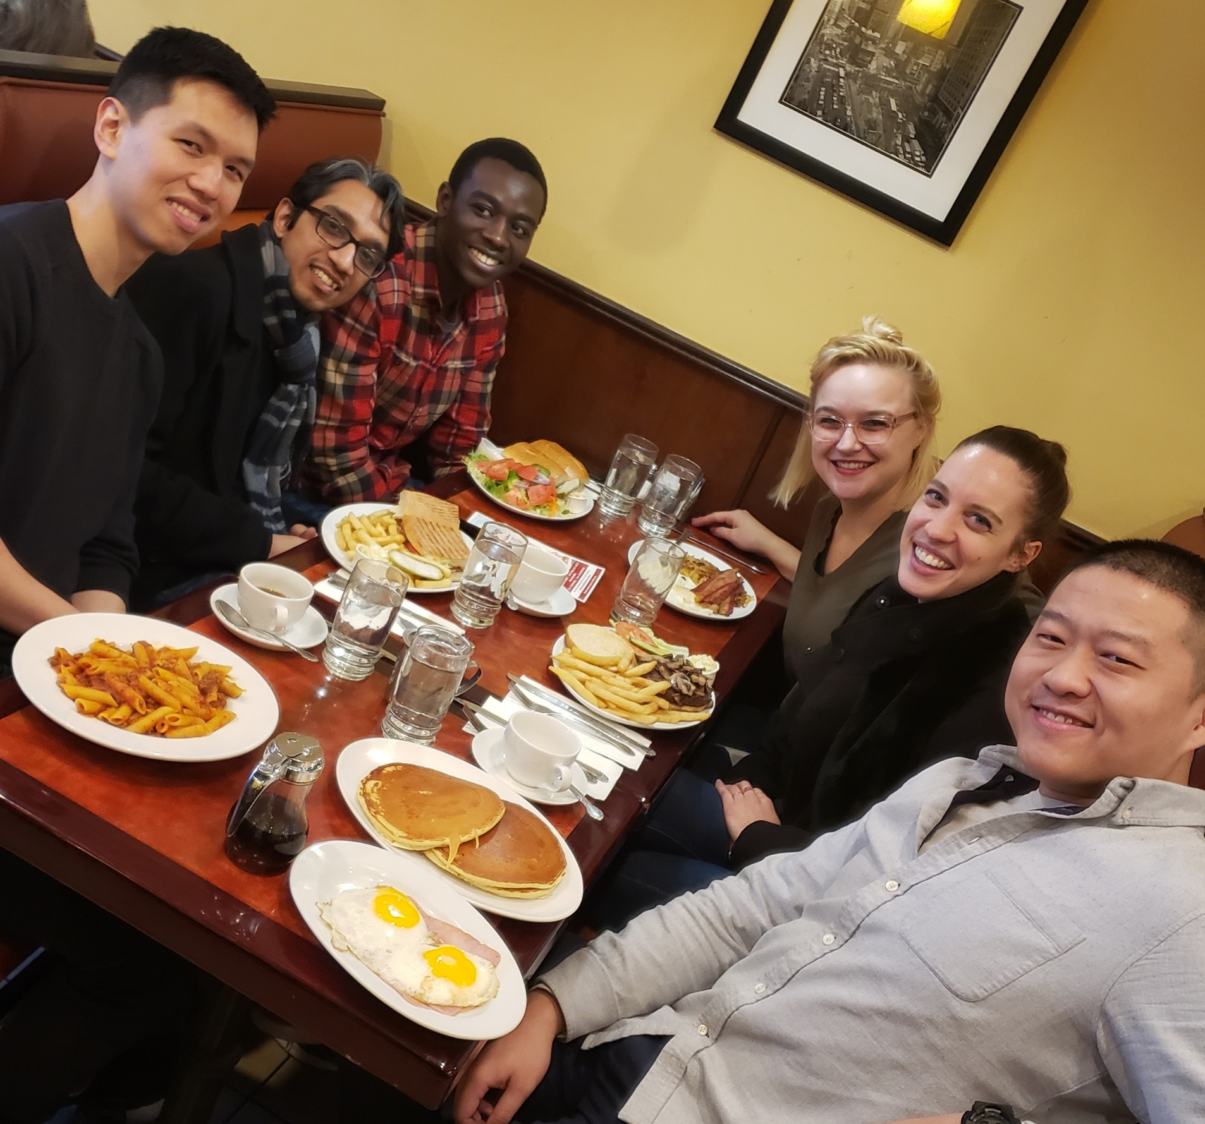
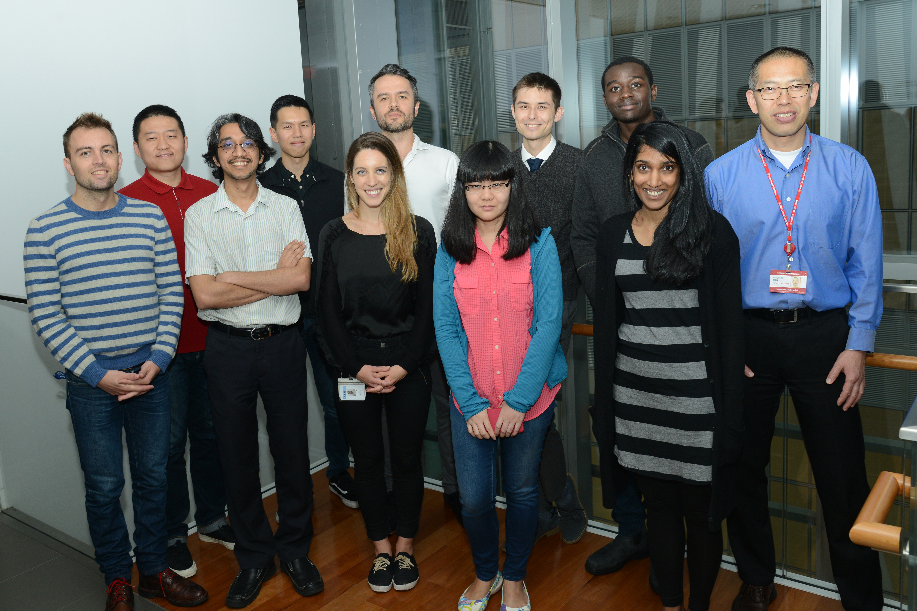
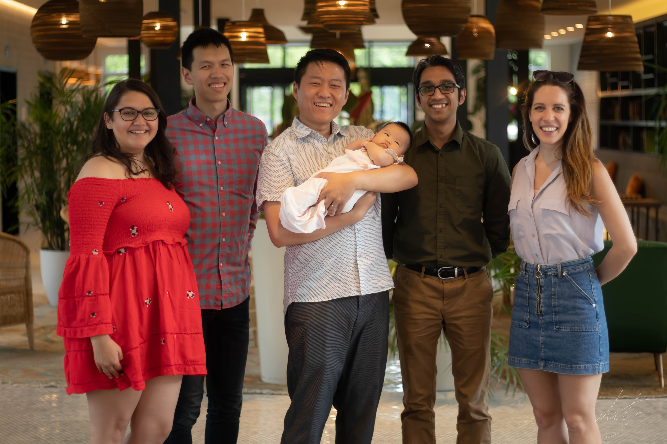
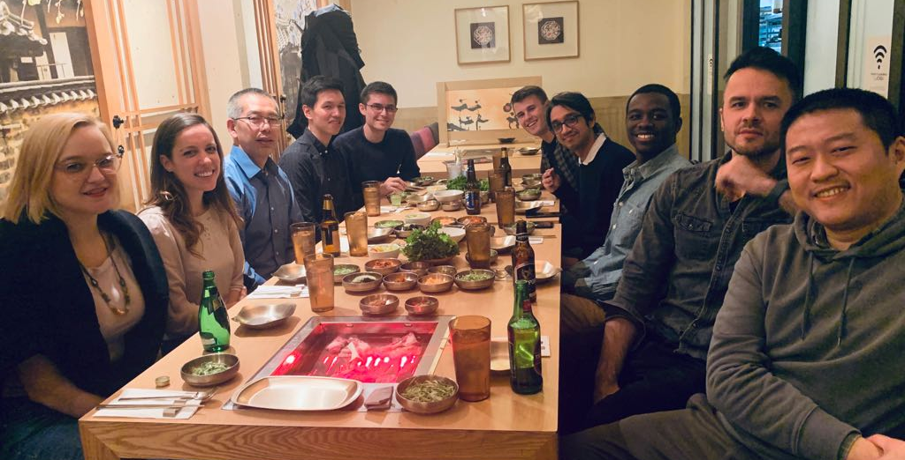
Marcin Imielinski lab

Slide 3
A genome graph paradigm for cancer genome structure
Xiaotong Yao
Advisor: Marcin Imielinski
In partial fulfillment of the requirements for the degree of
Doctor of Philosophy
08/12/2021

Slide 4
Outline
Intro: From patterns to mutagenesis
A graph model for rearranged genomes
Reconstructing junction-balanced genome graphs from WGS data
Distinct classes of SVs by analyzing genome graphs
SV evolution after telomere crisis
Integrating genome graphs to cancer whole genome analysis

Slide 5
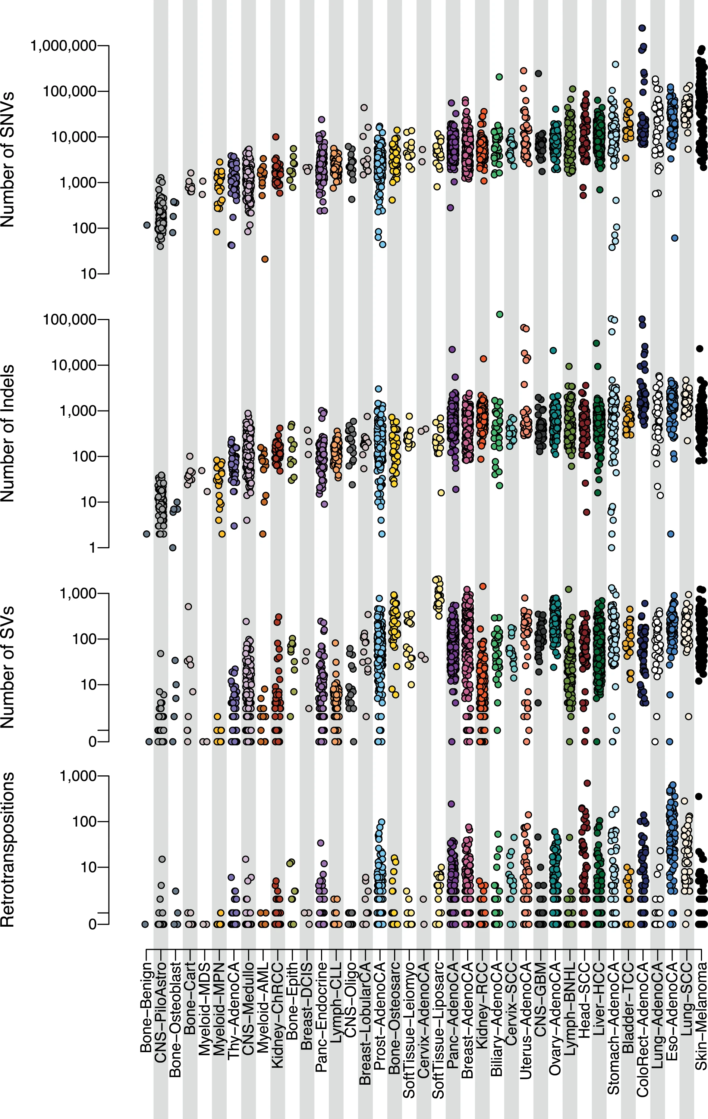
Genome instability is a hallmark of cancer
SNV
(single nucleotide variant)
INDEL
(insertion & deletion)
SV
(structural variant)
Retrotrasposition
PCAWG 2020 Nature

Slide 6
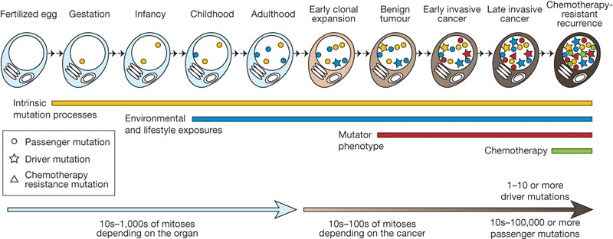
Variants in a cancer genome result from mutagenesis, repair, and evolution
Stratton, M. R., Campbell, P. J. & Futreal, P. A. Nature 458, 719–724 (2009)

Slide 7
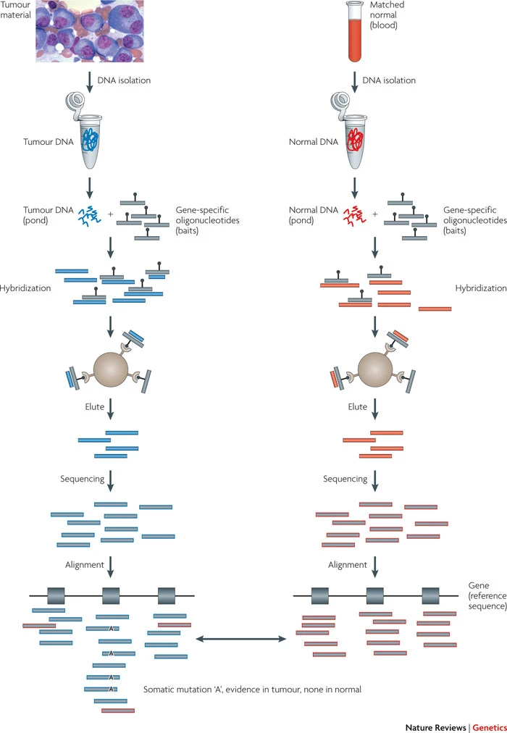
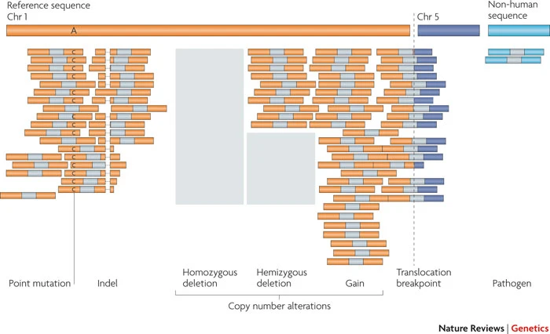
Genomic sequencing enables profiling of variants
Meyerson, M., Gabriel, S. & Getz, G. Nat. Rev. Genet. 11, 685–696 (2010)

Slide 8
Patterns of variant
Mutagenesis pathway

Slide 9
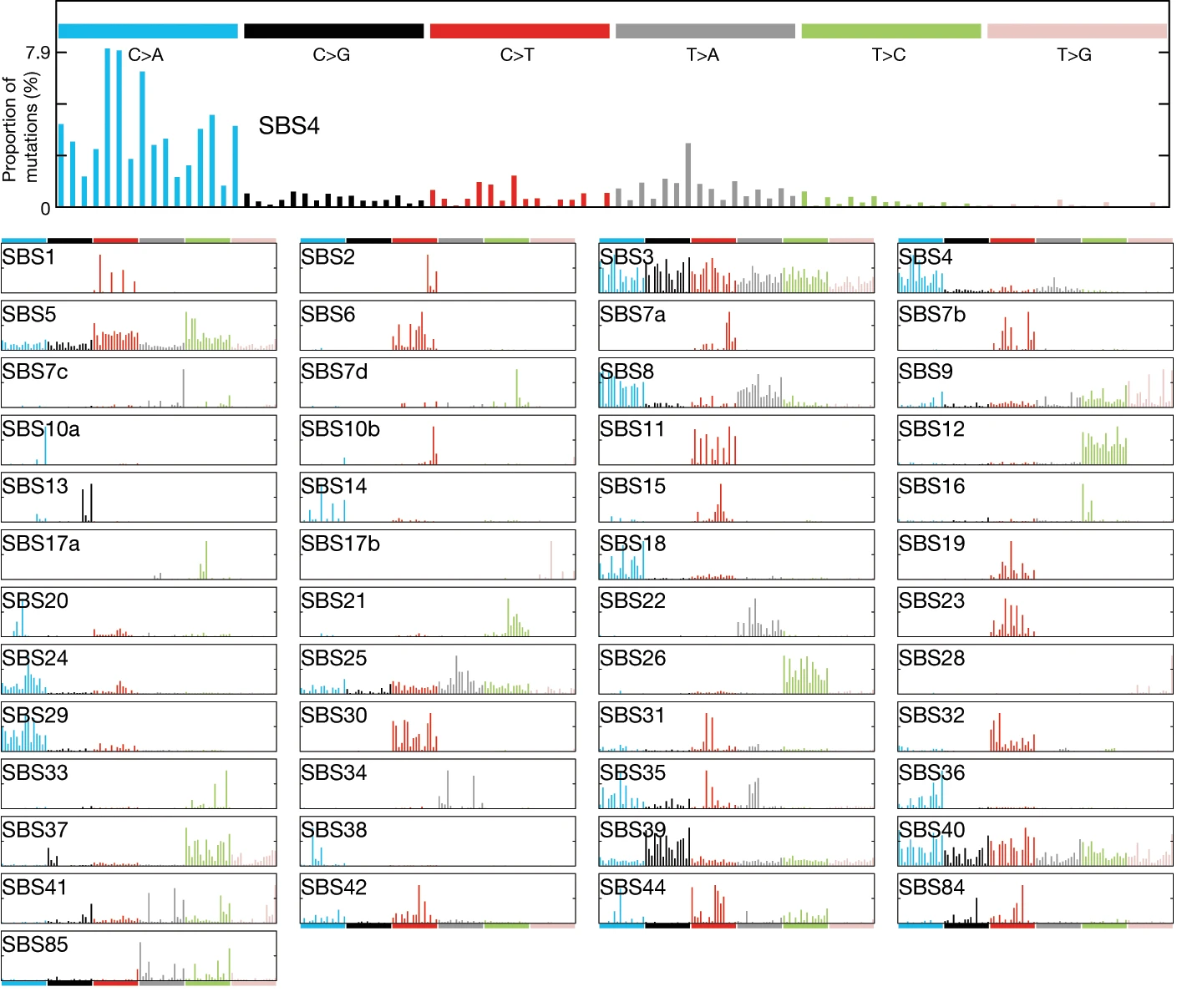
Patterns of somatic variants
Alexandrov, L. B. et al. Nature 578, 94–101 (2020)
Notes:
To know the origin/etiology of cancer we must know what genetic variations are in their genomes and subsequently find out how they acquired them.

Slide 10
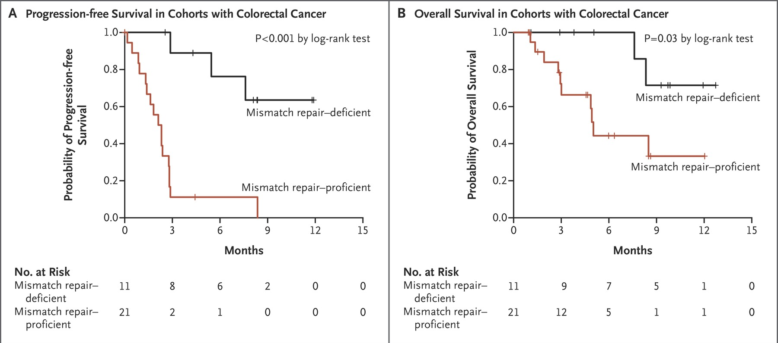
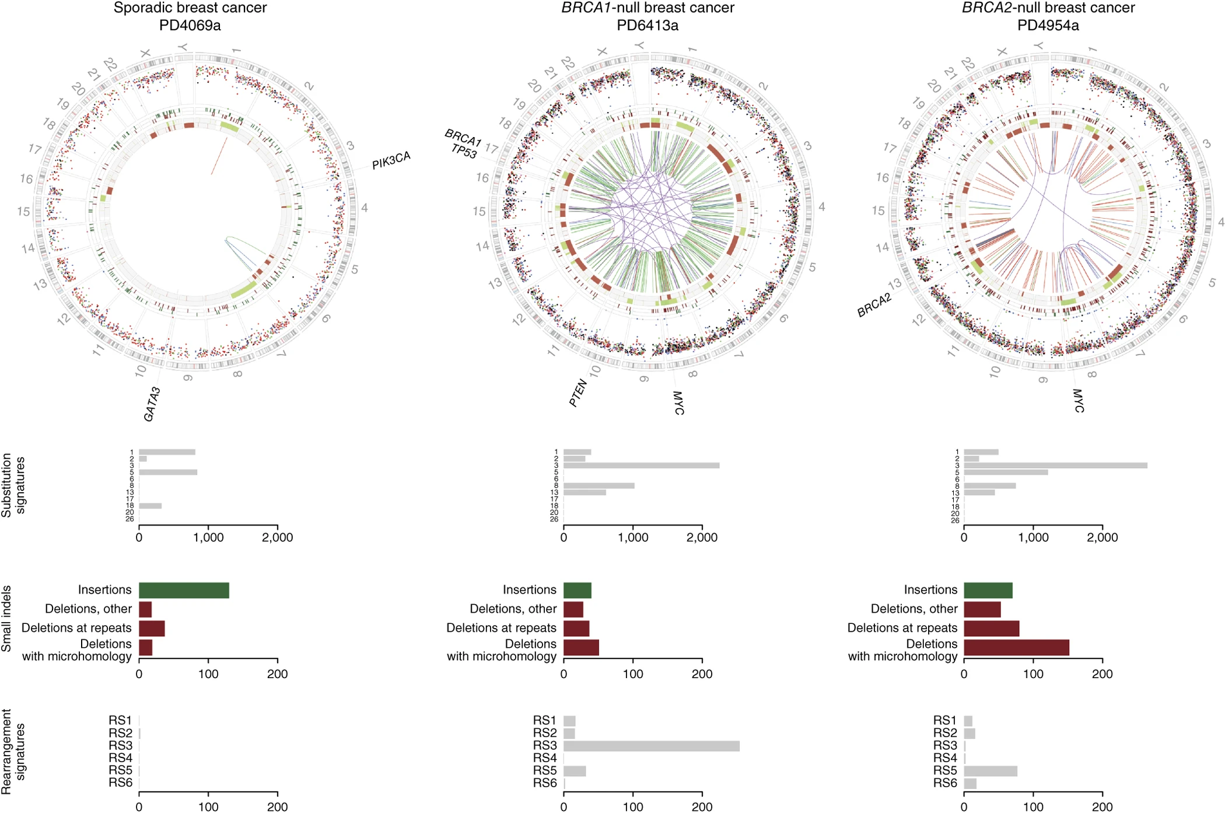
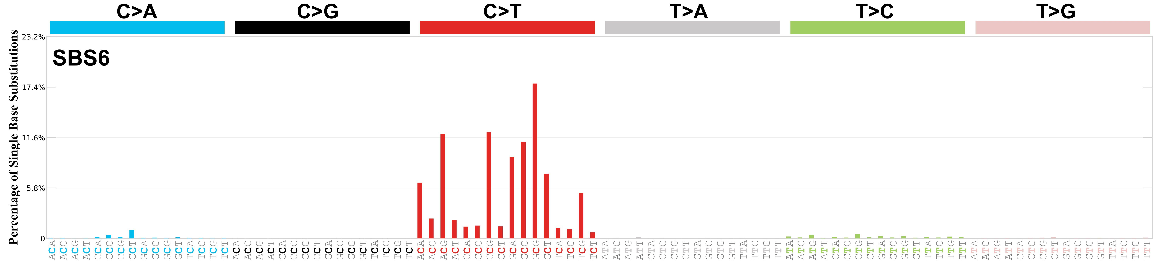
Patterns of variants and precision oncology
Davies, H. et al. Nat. Med. 23, 517–525 (2017)
Le, D. T. et al. N. Engl. J. Med. 372, 2509–2520 (2015)
Alexandrov, L. B. et al. Nature 578, 94–101 (2020)

Slide 11
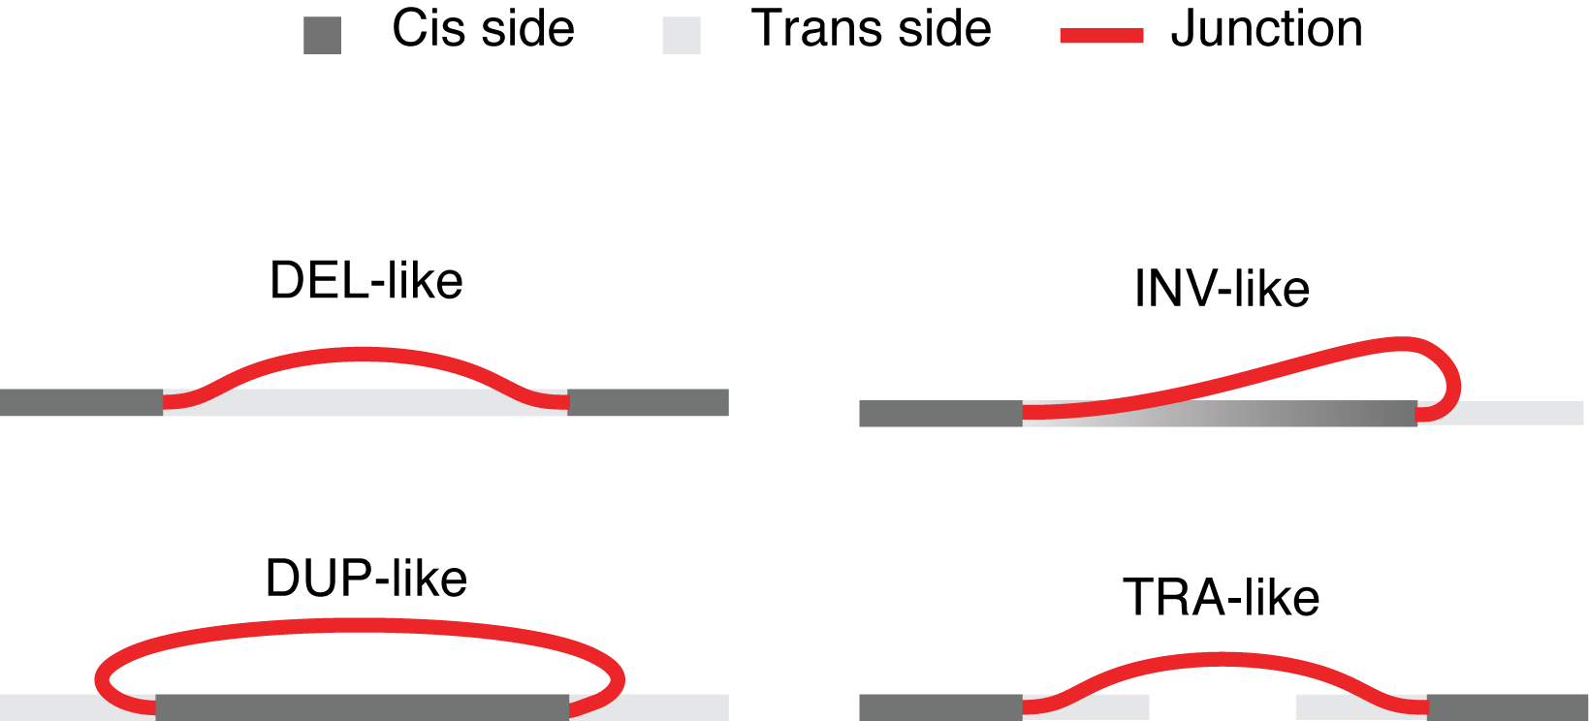
WGS detects SV as CNA and junction
Meyerson, M., Gabriel, S. & Getz, G. Nat. Rev. Genet. 11, 685–696 (2010)
Notes:
Thanks to the emergence of sequencing…

Slide 12
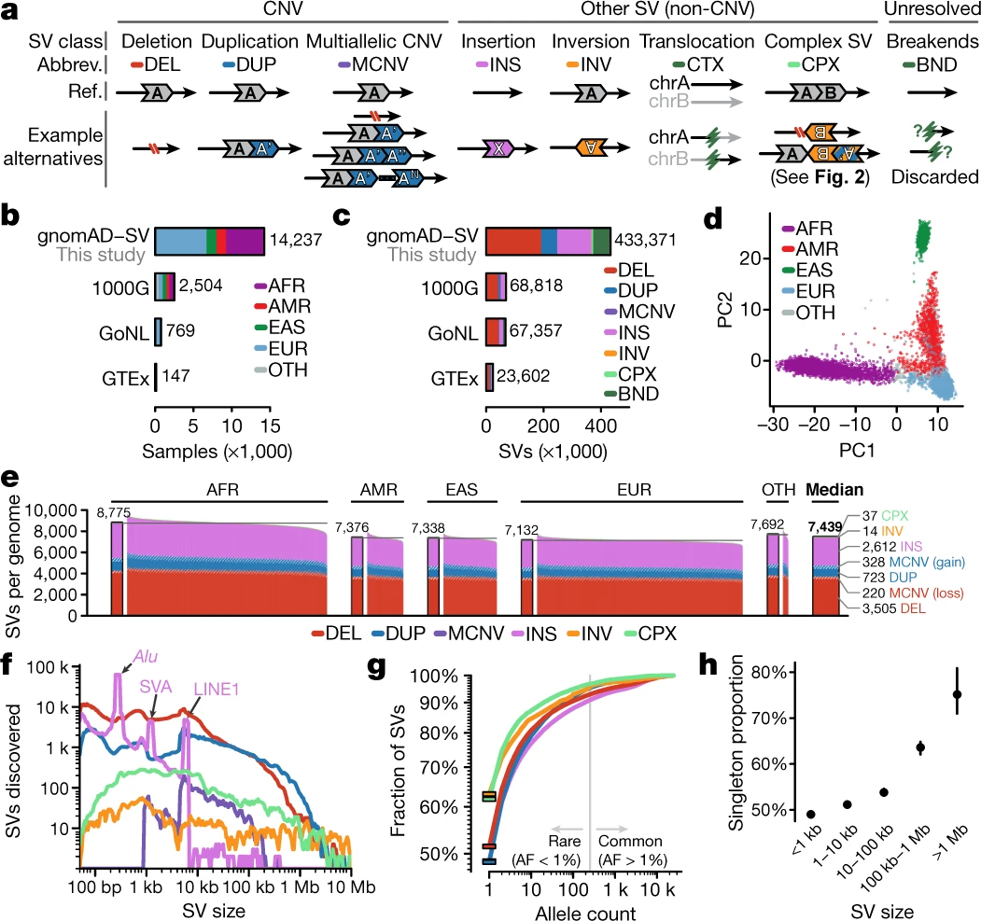
SVs in germline genomes are simpler
Collins, R. L. et al. Nature 581, 444–451 (2020)
Notes:
Most SV studies are first done in germline genomes, where events are relatively simple: composed of only 1 or 2 junctions and straightforward to categorize

Slide 13
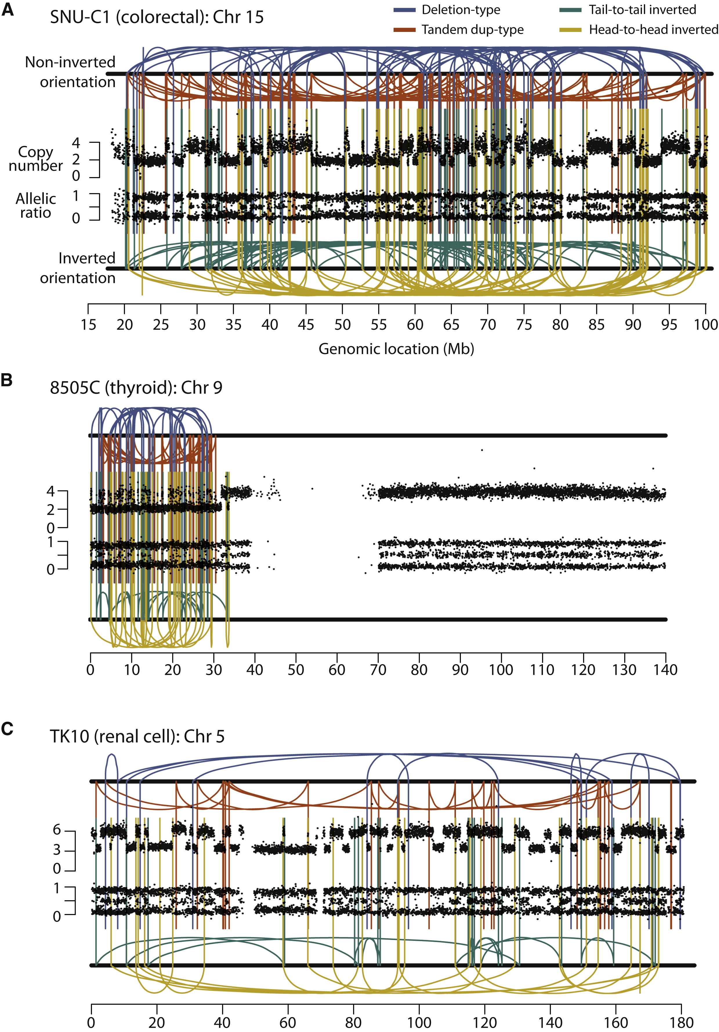
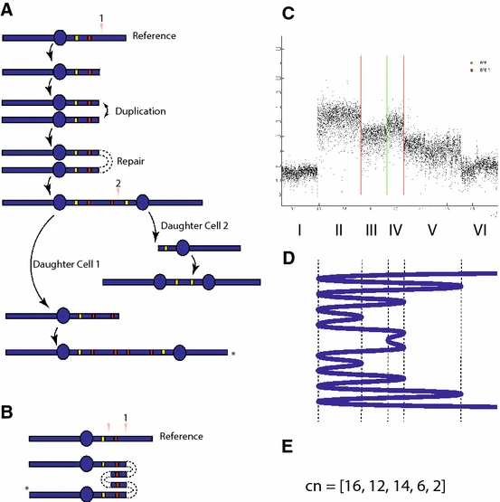
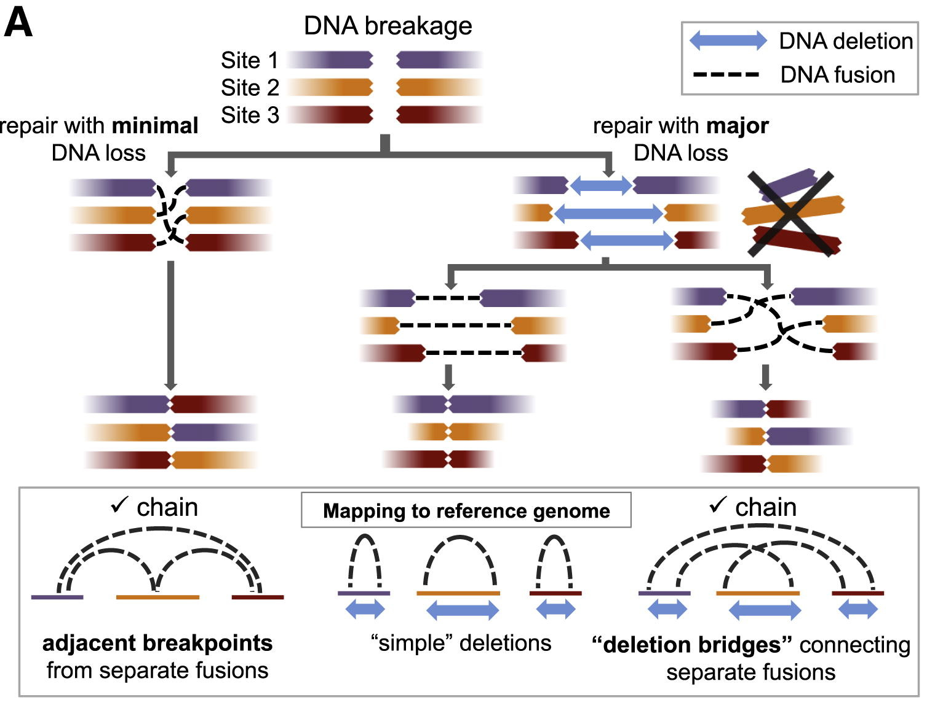
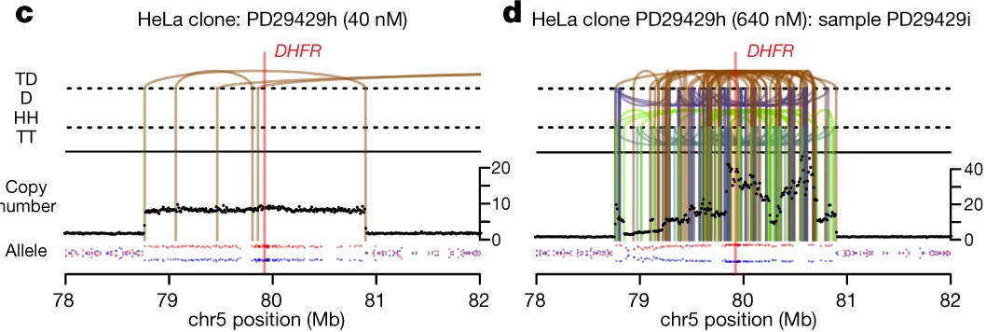
SVs in cancer genomes are much more complex
Stephens, P. J. et al. Cell 144, 27–40 (2011)
Baca, S. C. et al. Cell 153, 666–677 (2013)
Greenman, C. D. et al. J. Math. Biol. 72, 47–86 (2016)
Shoshani, O. et al. Nature (2020)

Slide 14
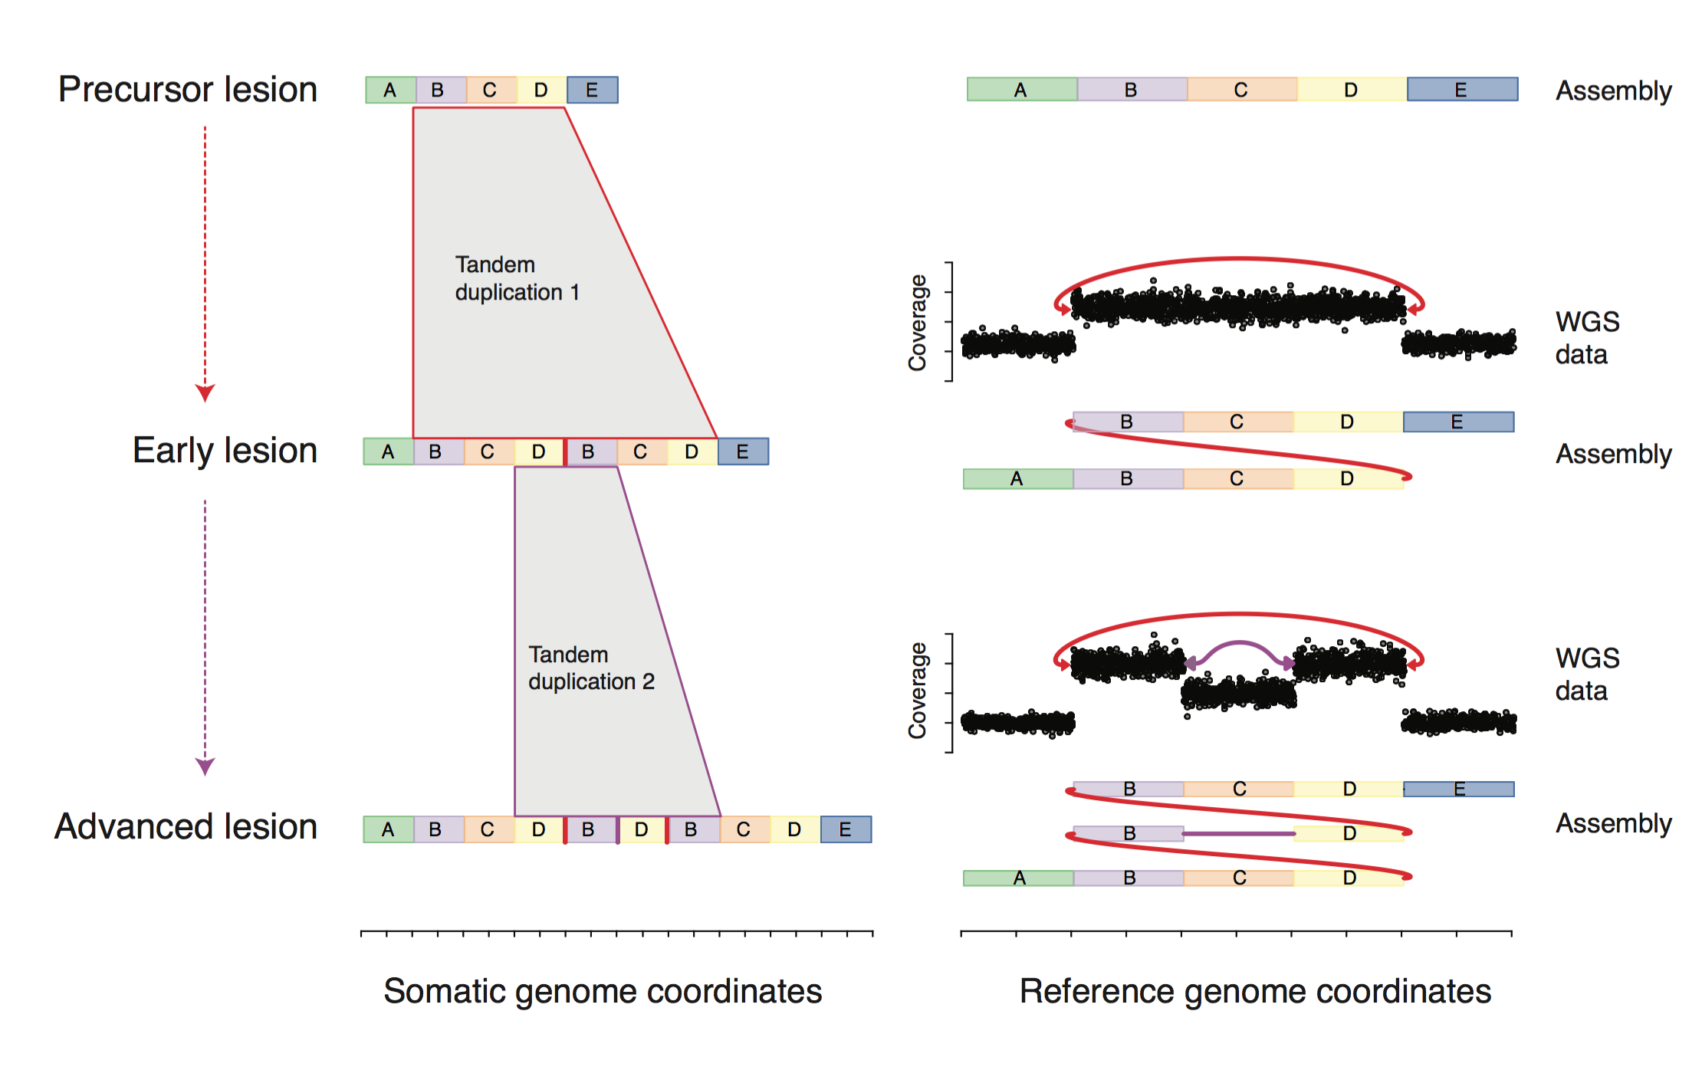
SV complexity complicates discovery
Maciejowski, J. & Imielinski, M. Current Opinion in Systems Biology (2016)
Notes:
Yet…

Slide 15
CHAPTER 2
Junction-balanced Genome Graphs Represent Structurally Altered Genomes

Slide 16
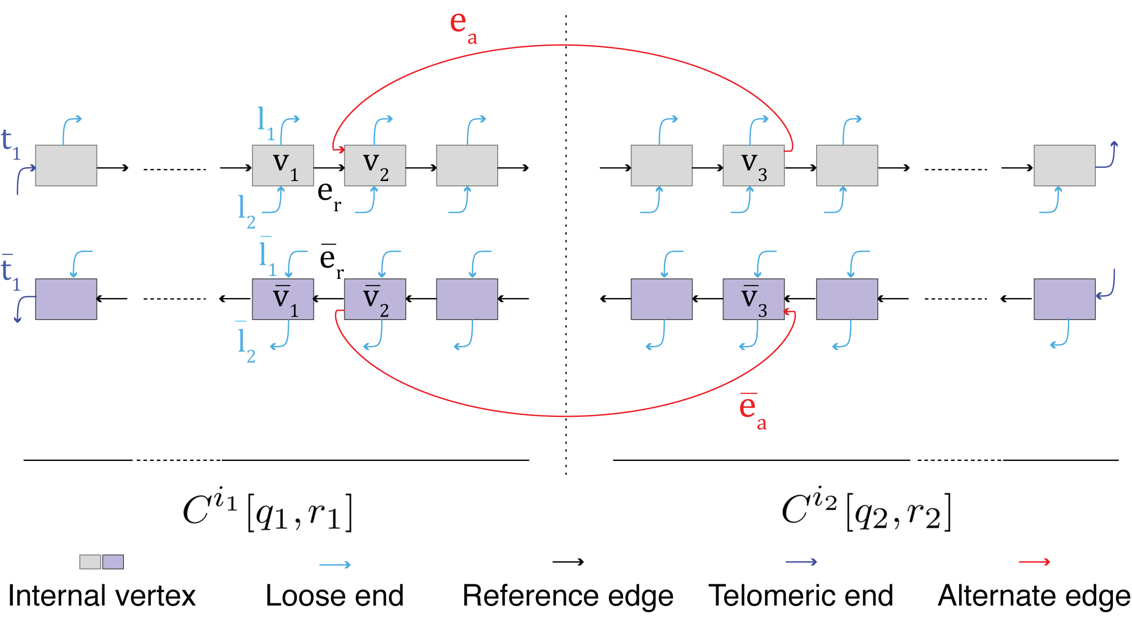
Genome graph: ssDNA vertex, 3’-5’ phosphodiester bond
Hadi, K. et al. Cell 183, 197–210.e32 (2020)

Slide 17
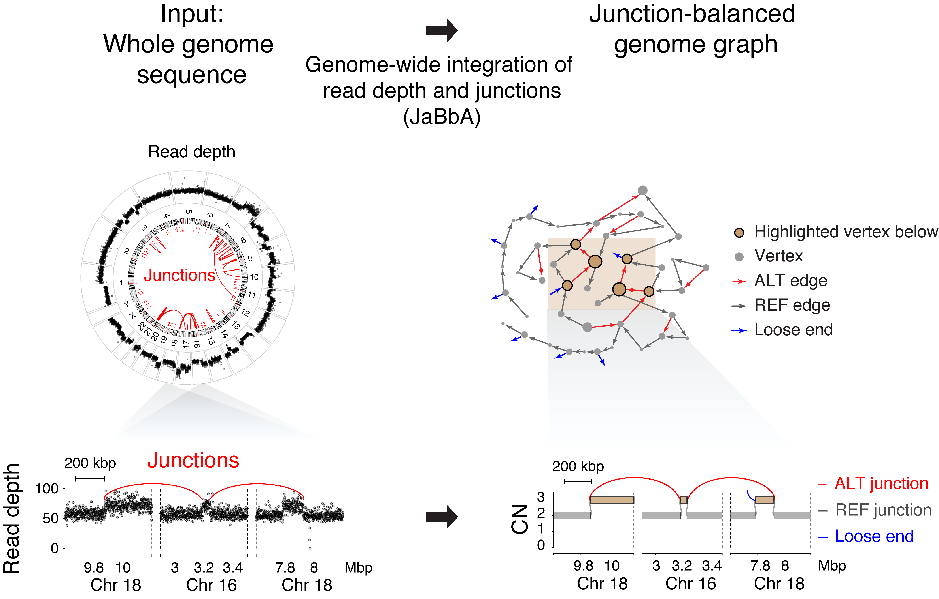
Junction-balanced genome graphs can be inferred

Slide 18
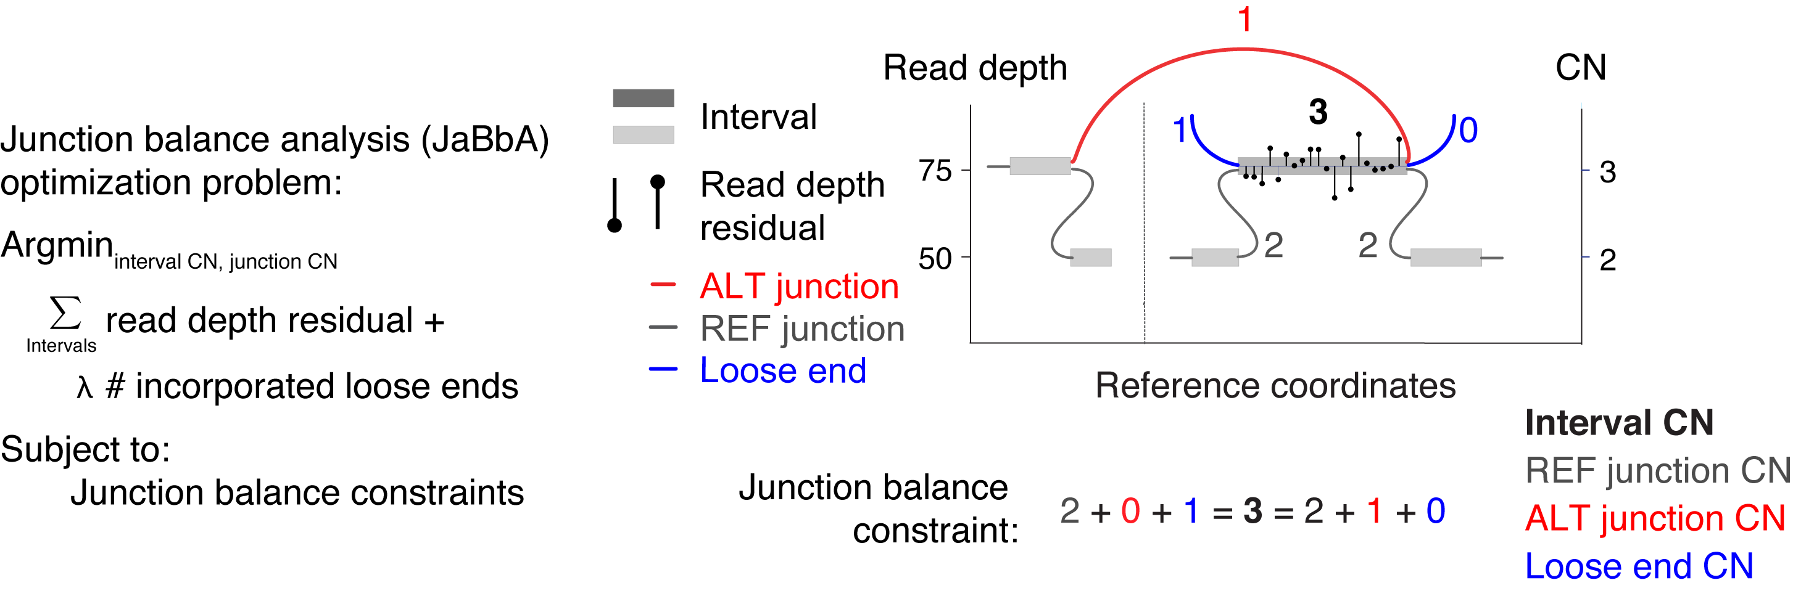
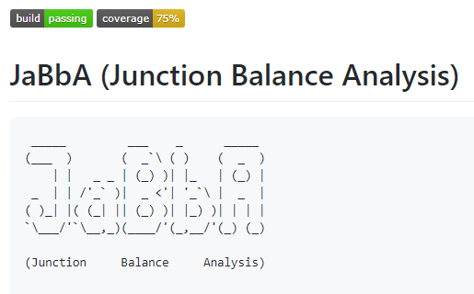
Junction balance Analysis (JaBbA)
https://github.com/mskilab/JaBbA
Hadi, K. et al. Cell 183, 197–210.e32 (2020)

Slide 19
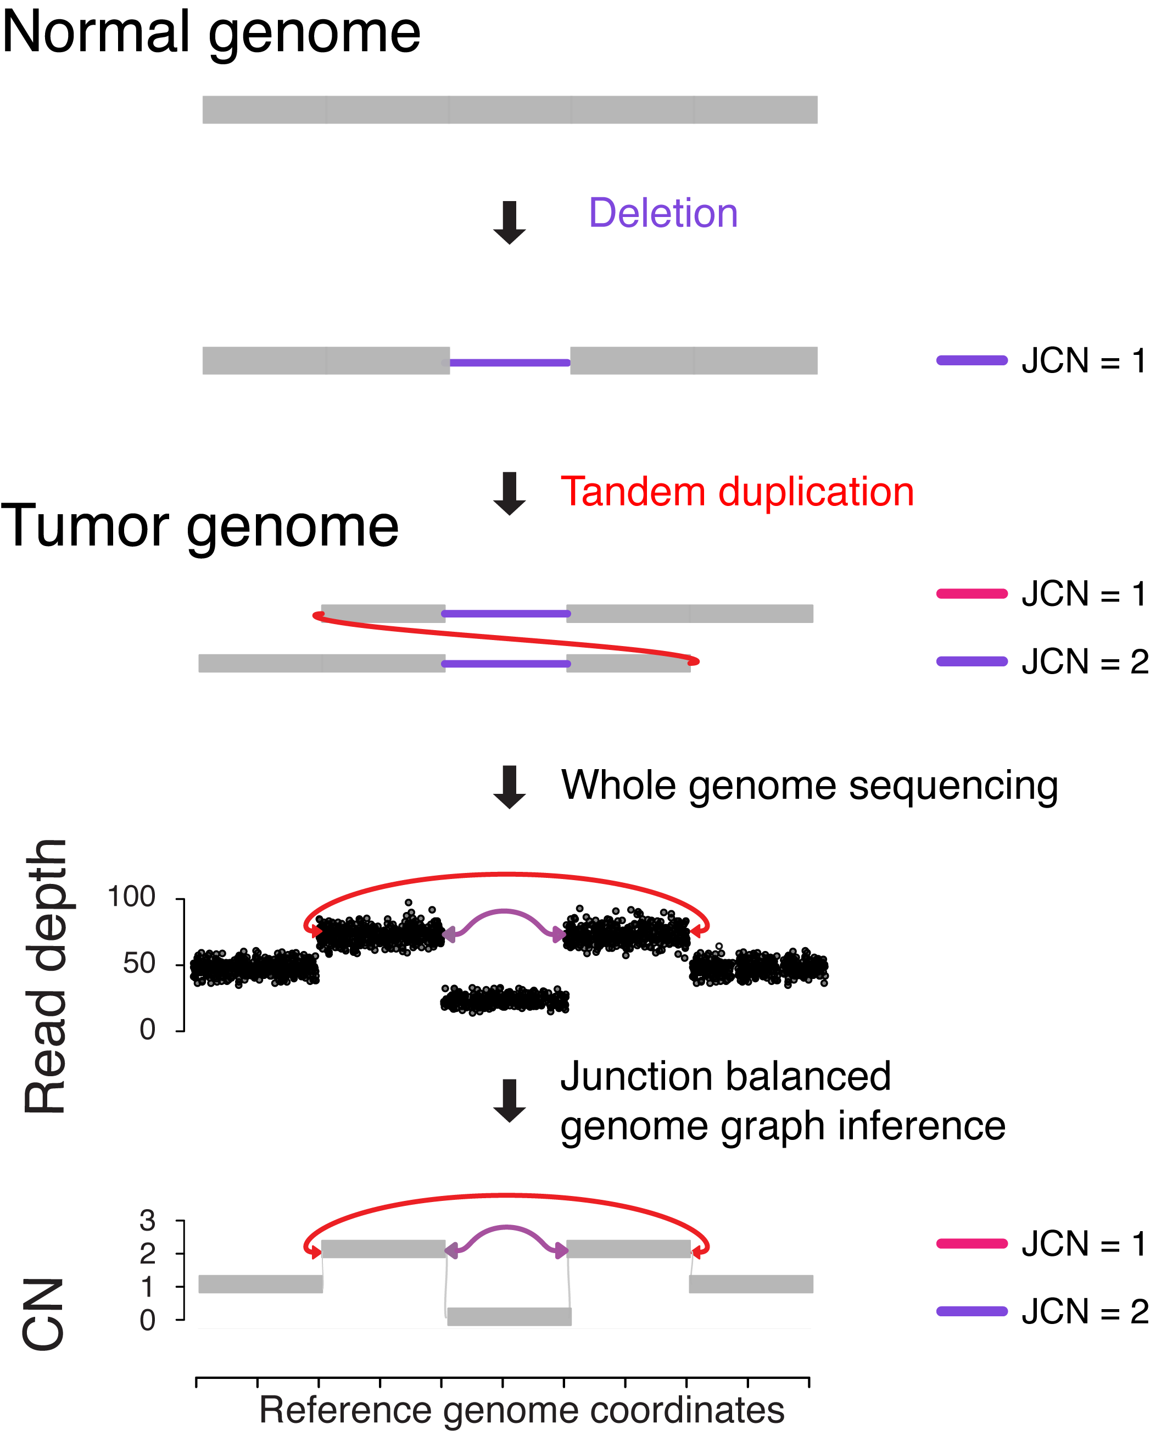
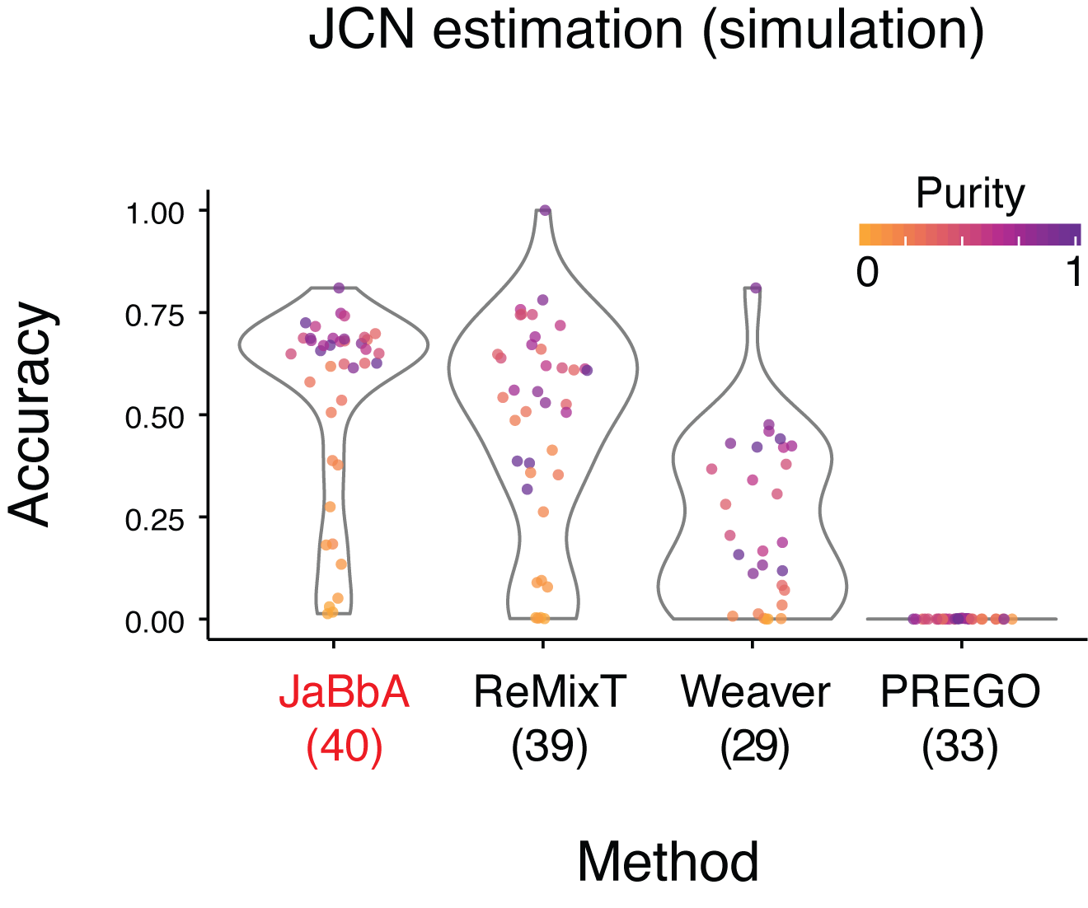
JaBbA accurately estimates junction copy number
Hadi, K. et al. Cell 183, 197–210.e32 (2020)

Slide 20
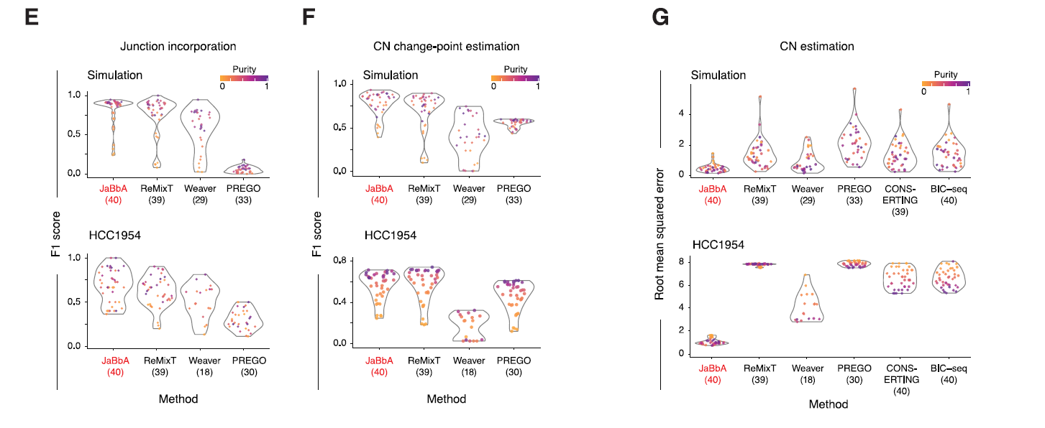
JaBbA incorporates the true junctions, places the true CN change points, and estimate accurate CN
Hadi, K. et al. Cell 183, 197–210.e32 (2020)

Slide 21
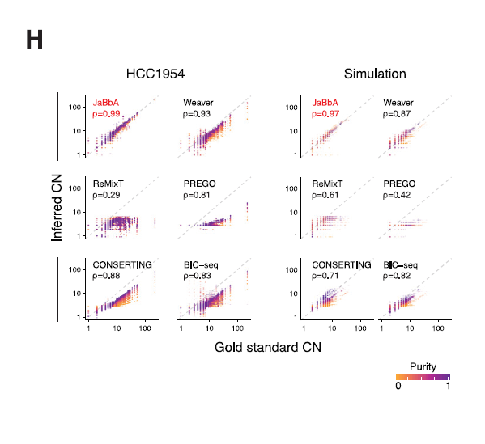
JaBbA: Higher fidelity + wider dynamic range
Hadi, K. et al. Cell 183, 197–210.e32 (2020)

Slide 22
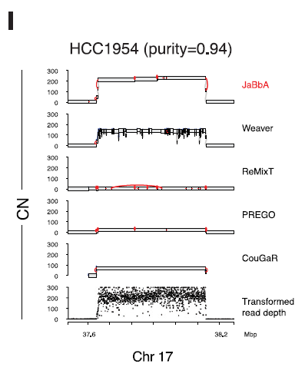
Reconstructed HER2 amplicon by BFB
Hadi, K. et al. Cell 183, 197–210.e32 (2020)

Slide 23
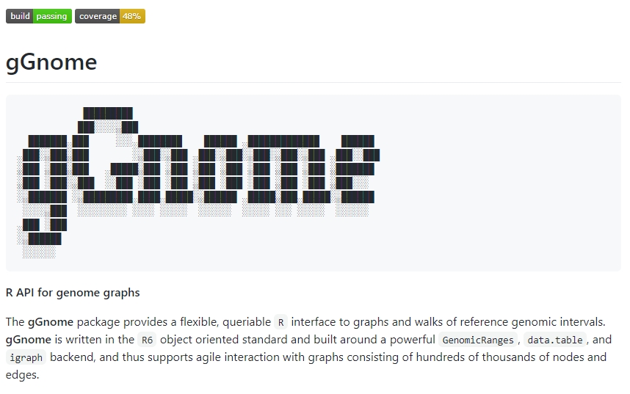
Application programming interface for genome graphs
https://github.com/mskilab/gGnome
http://mskilab.com/gGnome/tutorial.html

Slide 24
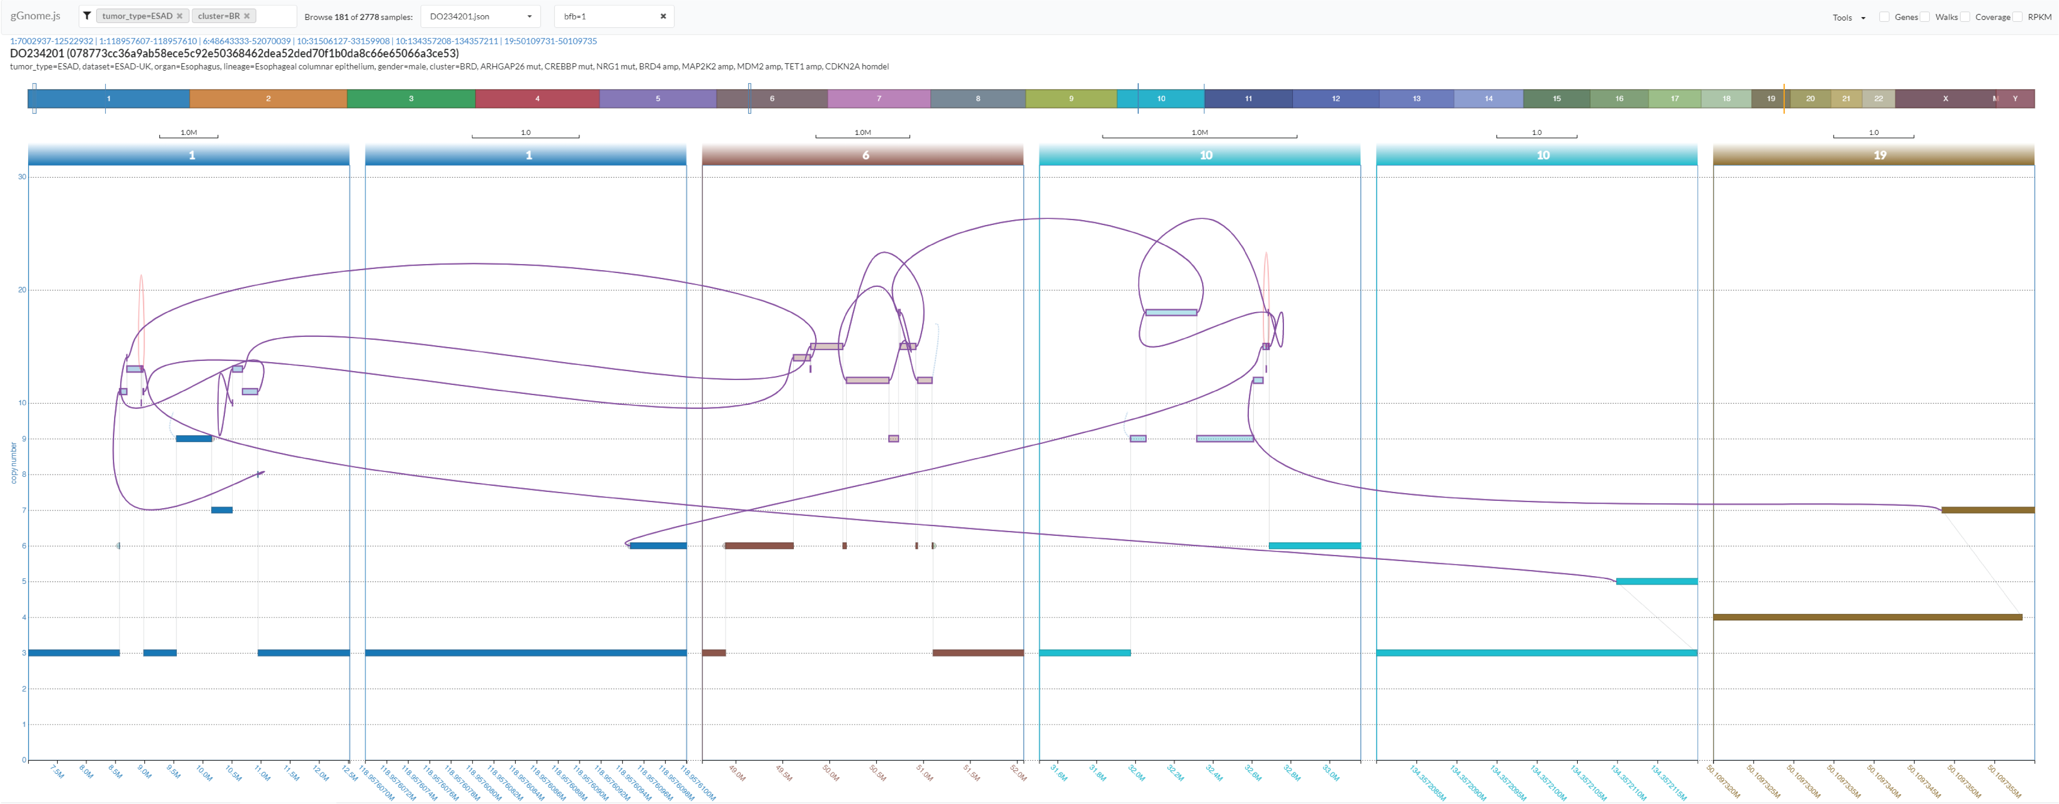
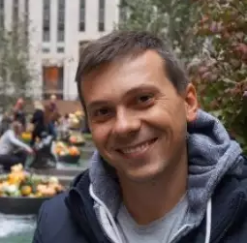
Interactive visualization of genome graphs
Charalampos Xanthopoulakis
http://mskilab.com/gGraph

Slide 25
Conclusions
Defined genome graph data structure to represent rearranged genomes
Developed Junction Balance Analysis to accurately and robustly infer genome graphs from WGS
Built practical and versatile APIs for genome graphs
Designed interactive genome browser visualizing genome graphs over discontiguous windows

Slide 26
CHAPTER 3
Distinct Classes Of Complex Structural Variant Uncovered Across Thousands Of Cancer Genome Graphs

Slide 27
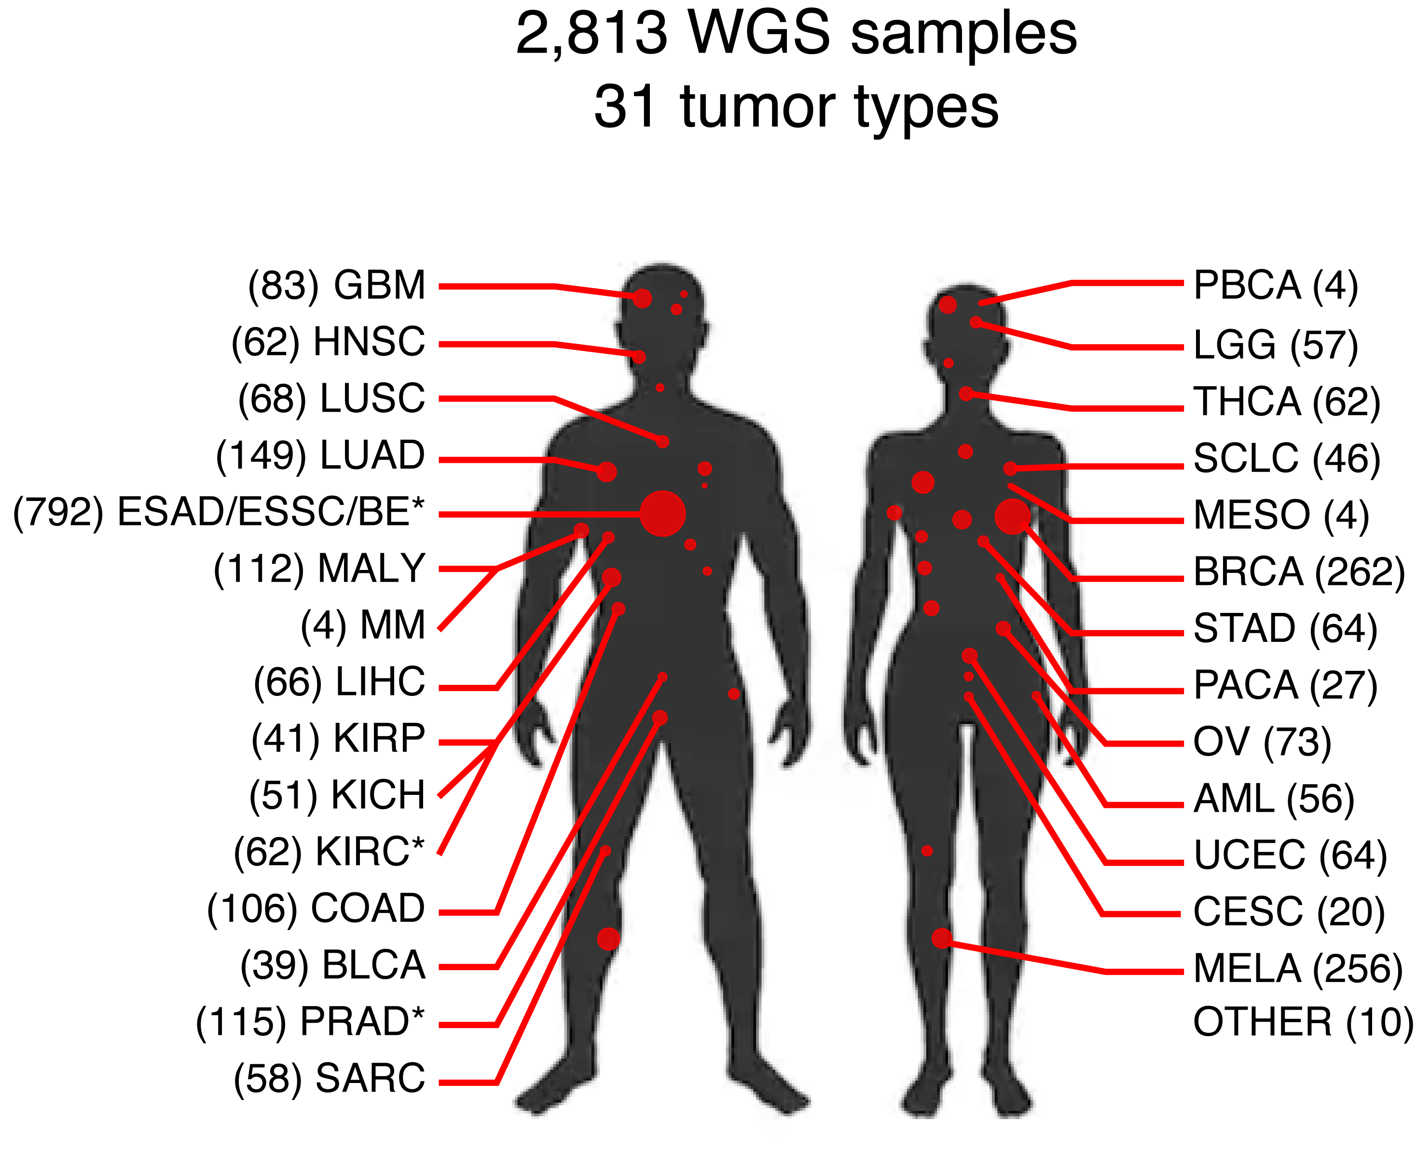
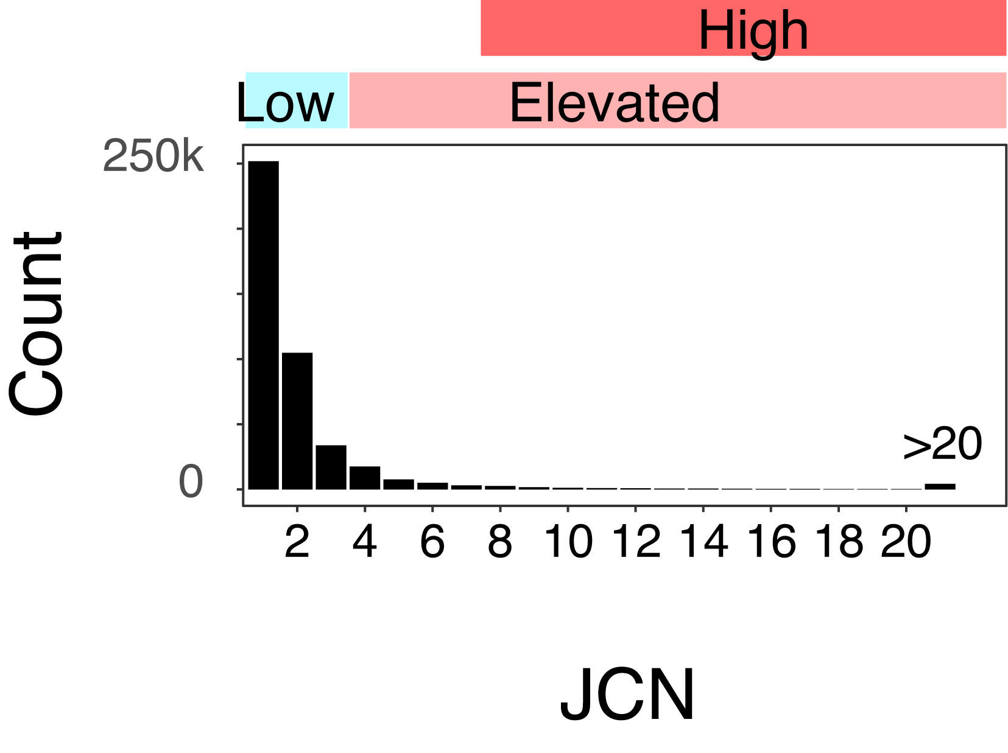
Pan-cancer genome graphs define distinct classes of SVs
Hadi, K. et al. Cell 183, 197–210.e32 (2020)

Slide 28
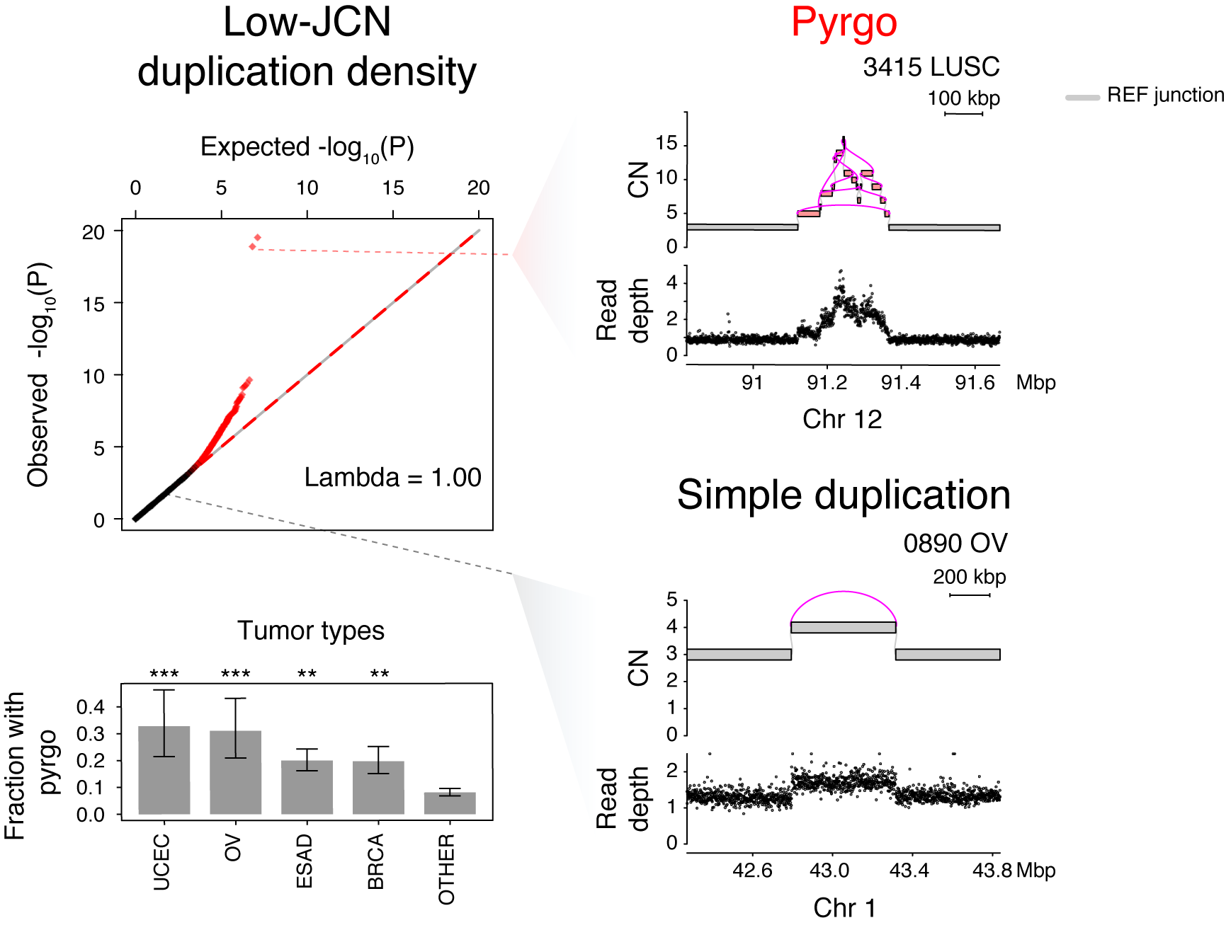
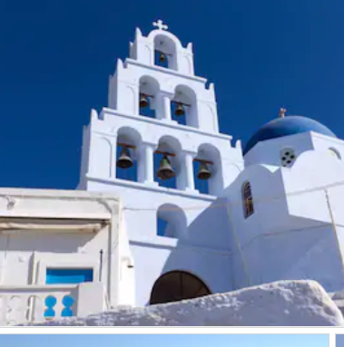
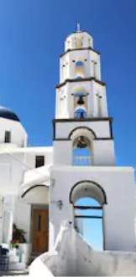
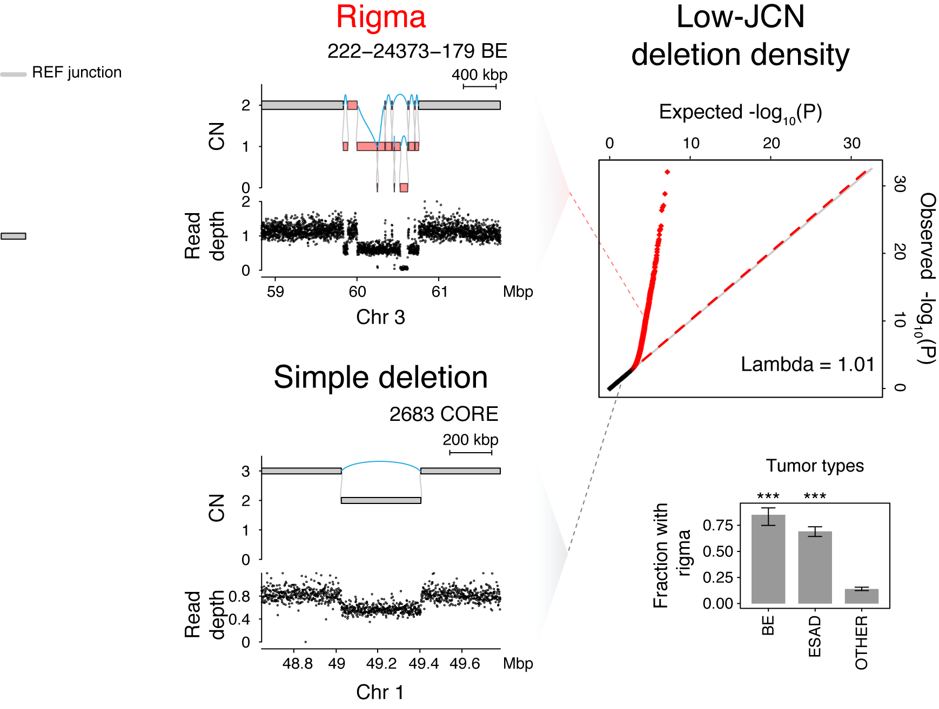
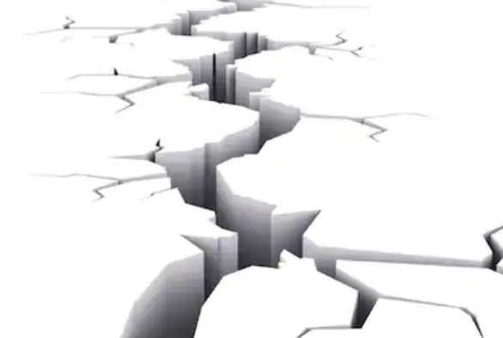
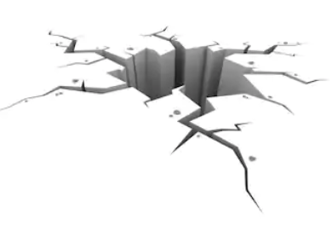
Pyrgo - tower of tandem duplications Rigma – rift of simple deletions
Hadi, K. et al. Cell 183, 197–210.e32 (2020)
Notes:
statistical model to rigorously nominate these. gamma poisson model the density of duplications across genomic regions for every sample. Regions that are density outliers, we coopt the word “pyrgo”, greek for tower. tumor type enrichments.

Slide 29
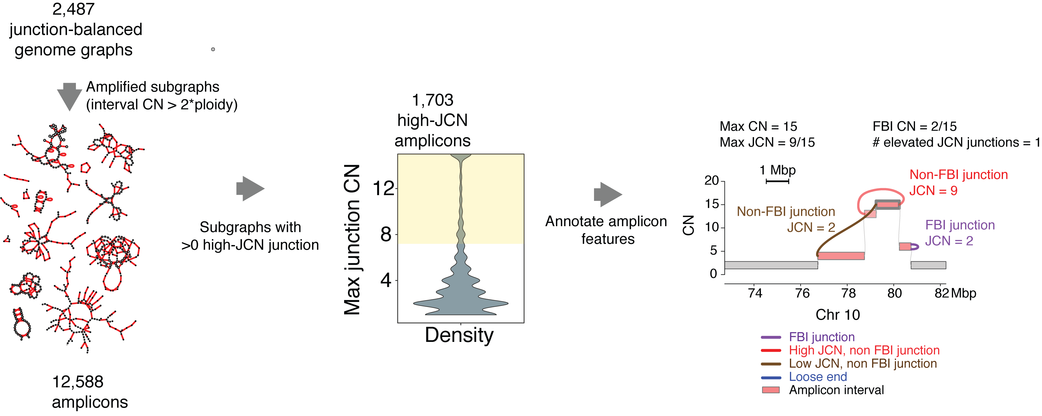
Clustering amplified subgraphs with high JCN
Hadi, K. et al. Cell 183, 197–210.e32 (2020)

Slide 30
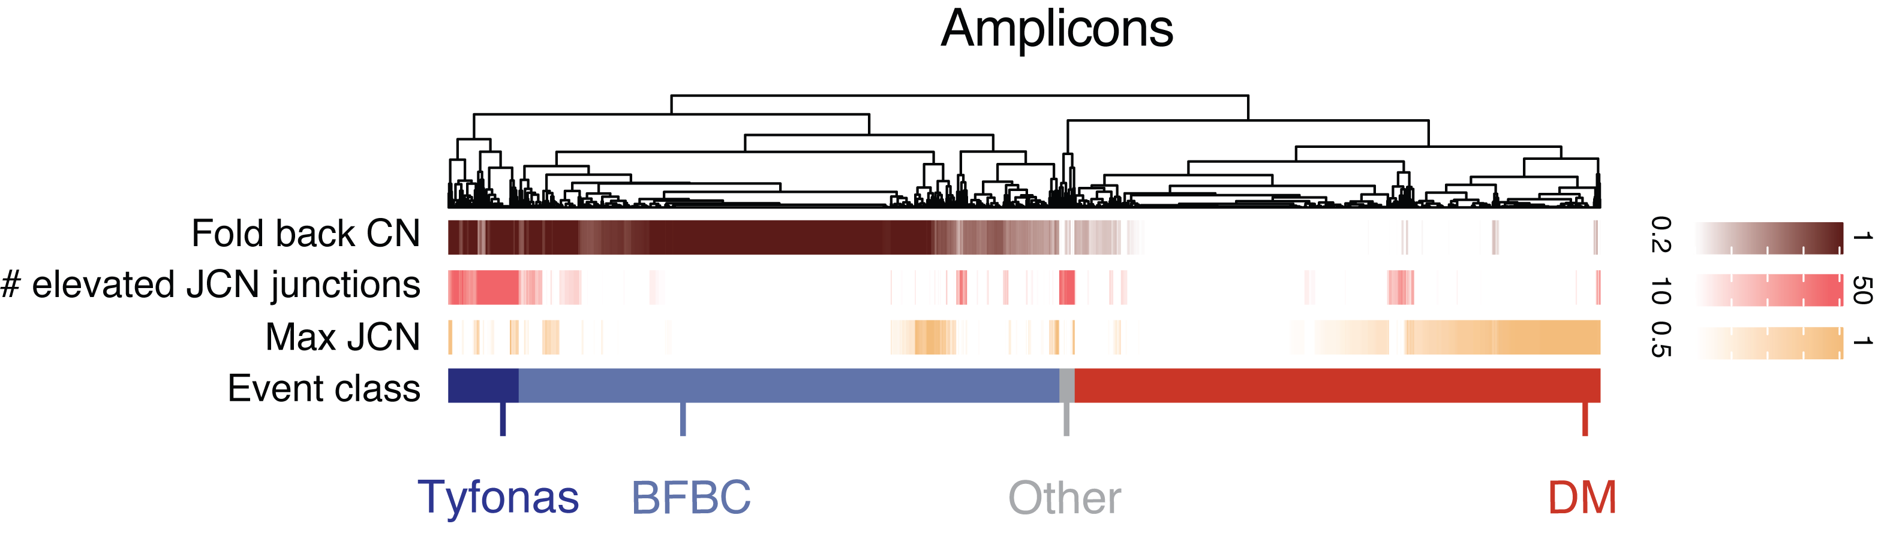
Max(JCN), FBI (CN), N(elevated JCN) separates double minute, breakage-fusion-bridge, and tyfonas
Hadi, K. et al. Cell 183, 197–210.e32 (2020)

Slide 31
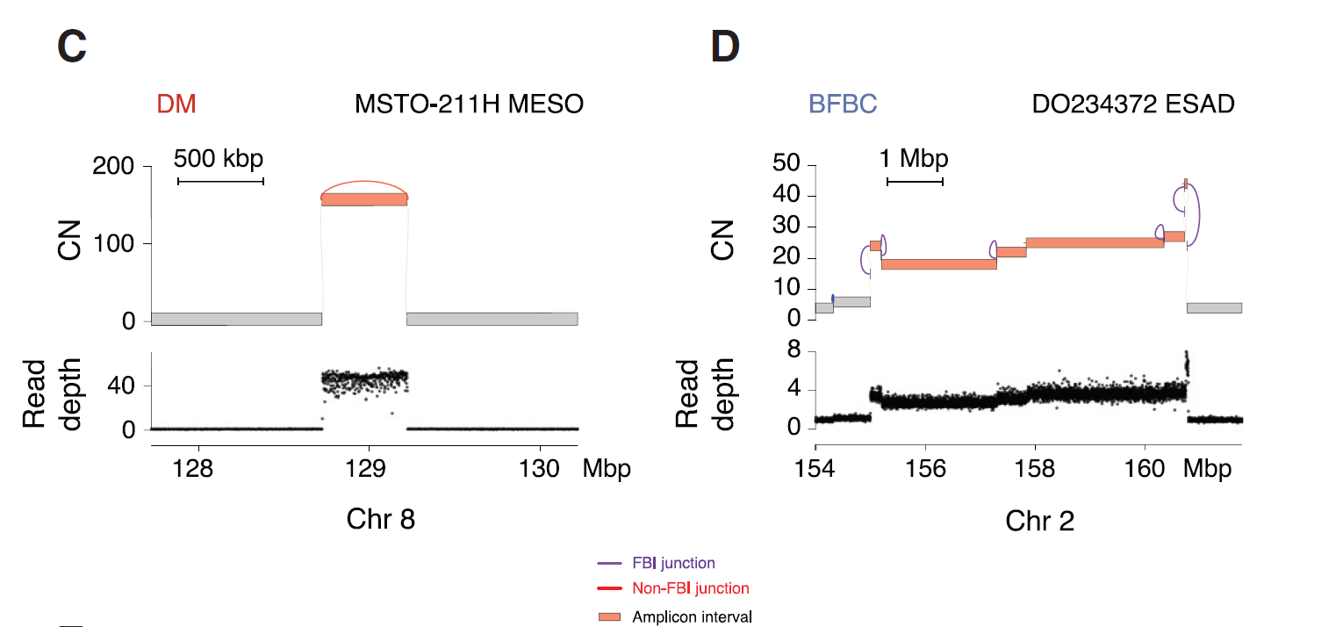
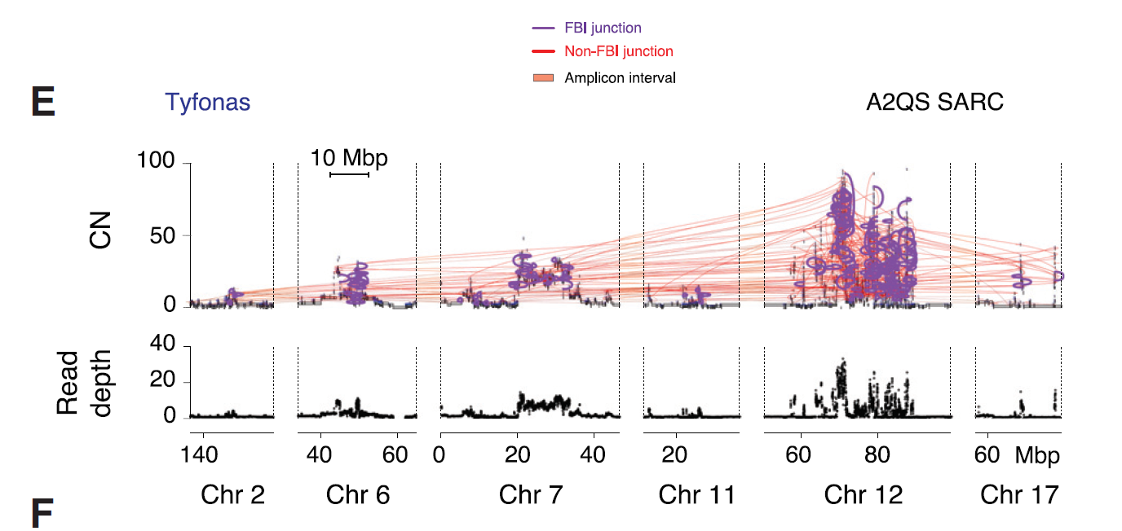
Tyfonas a distinct class of amplicon characterized by high elevat-JCN junction content, high FBI CN
Hadi, K. et al. Cell 183, 197–210.e32 (2020)

Slide 32
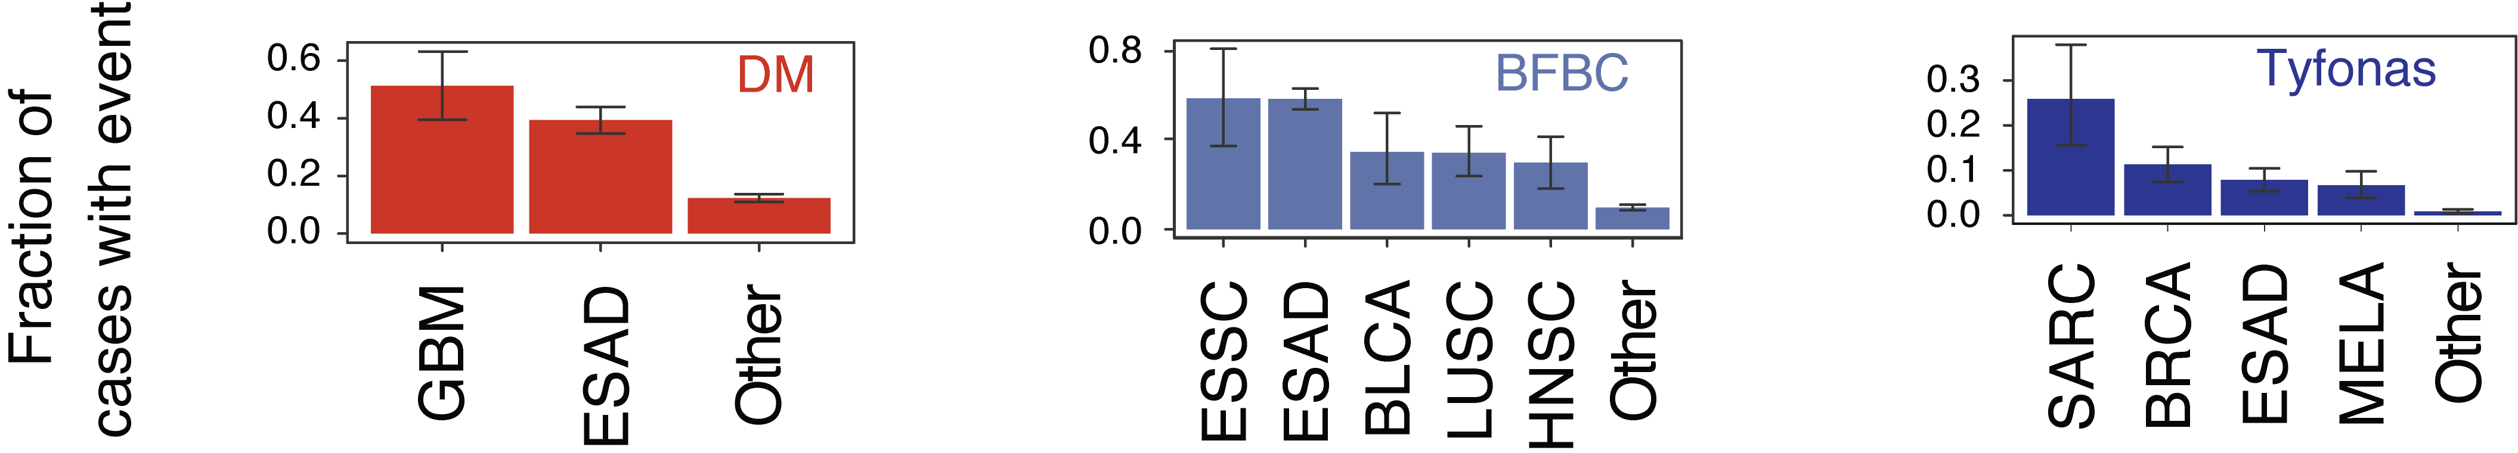
They enrich in different tumors
Hadi, K. et al. Cell 183, 197–210.e32 (2020)

Slide 33
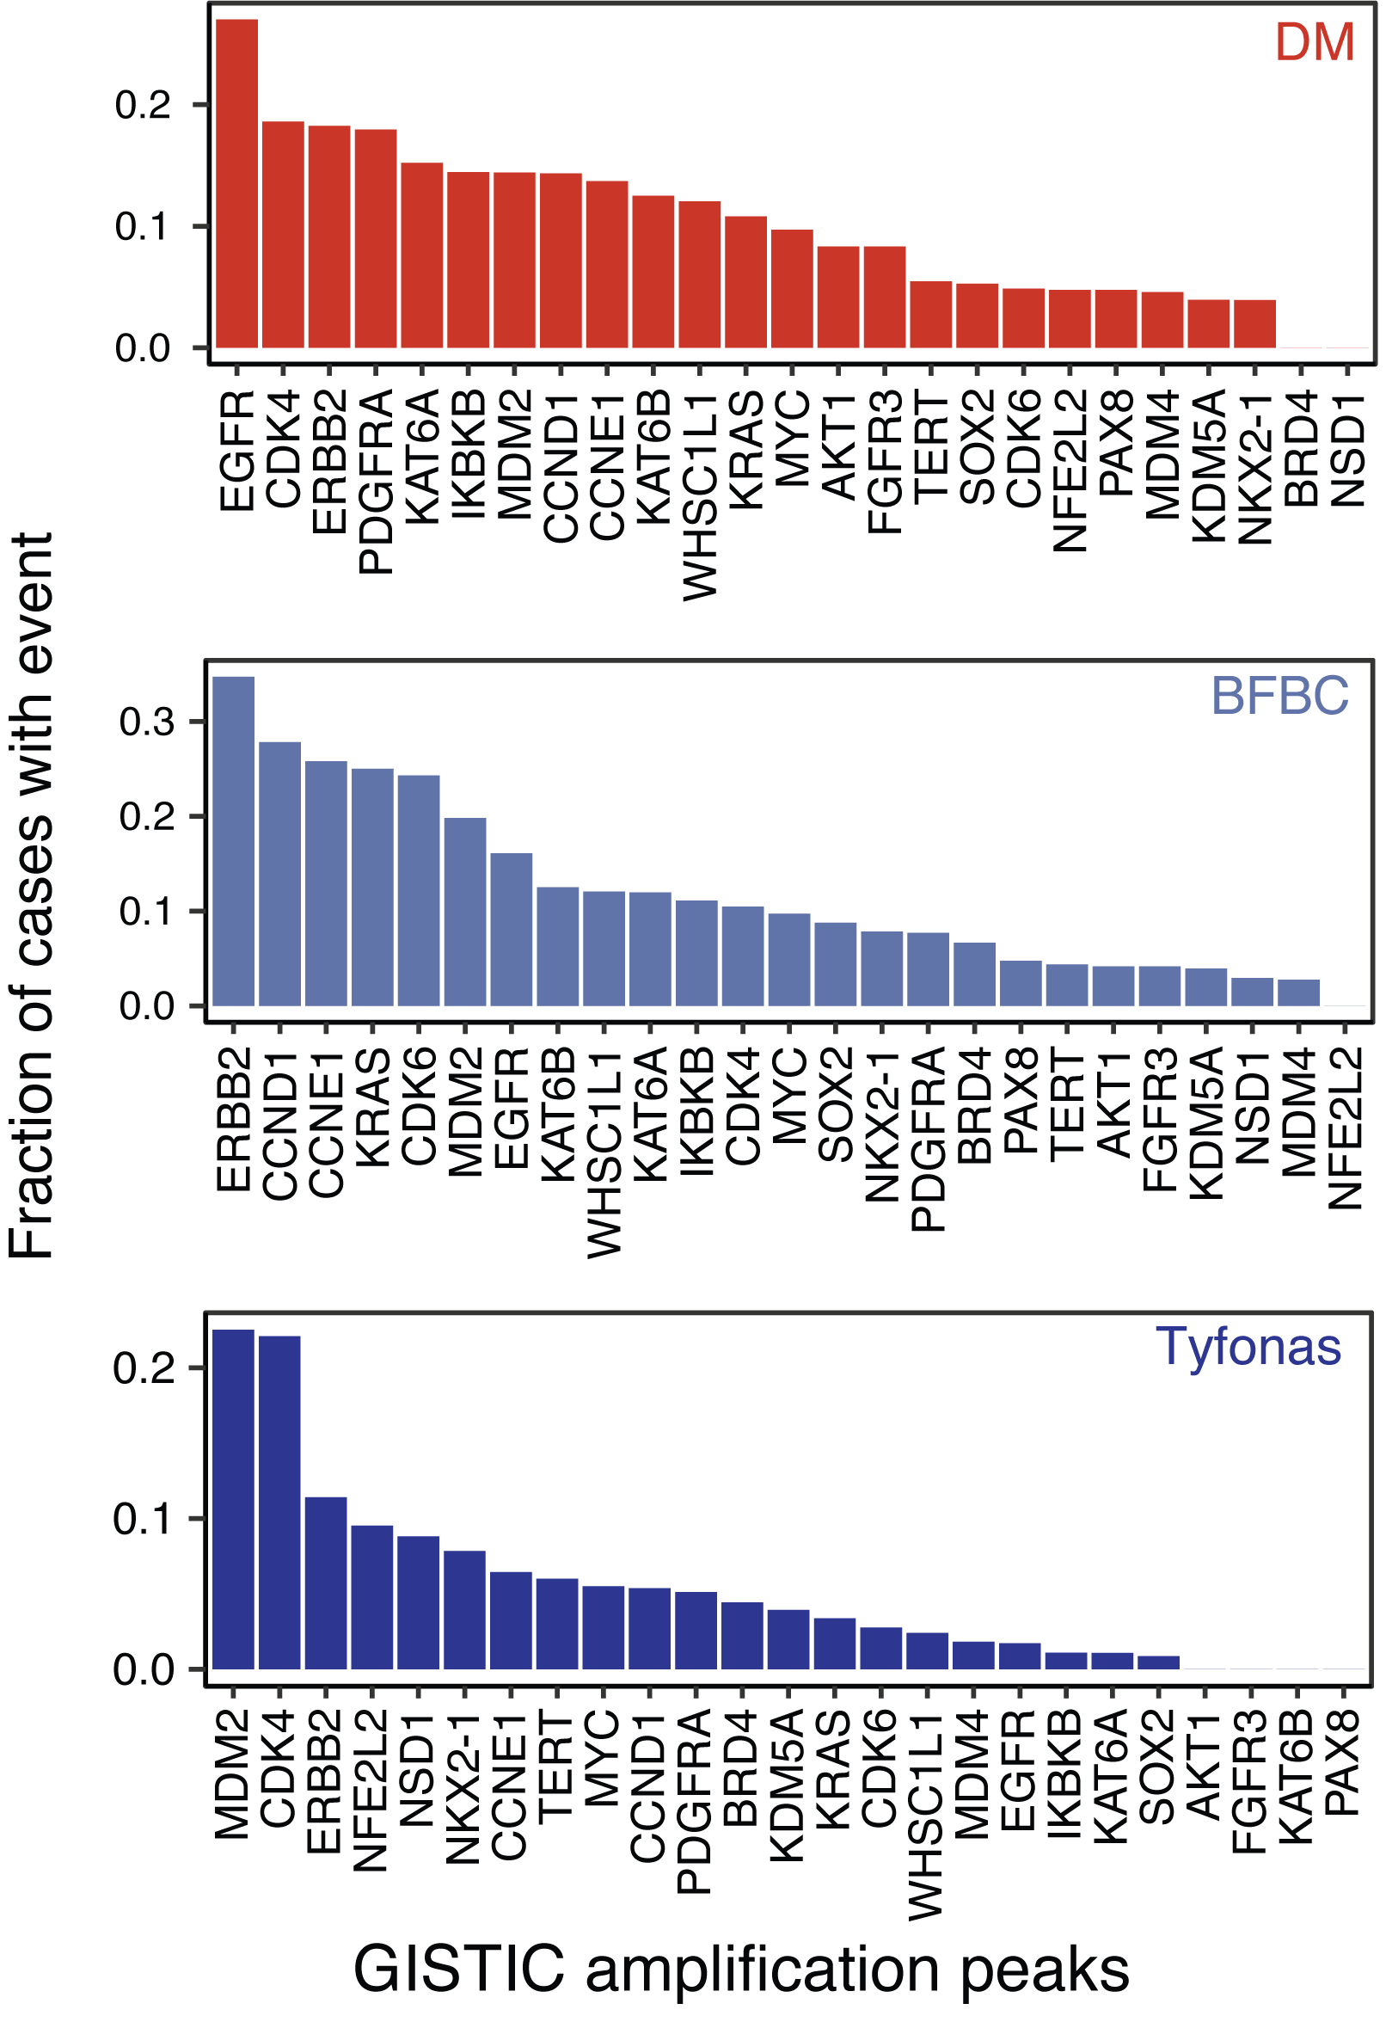
They amplify different drivers
Hadi, K. et al. Cell 183, 197–210.e32 (2020)

Slide 34
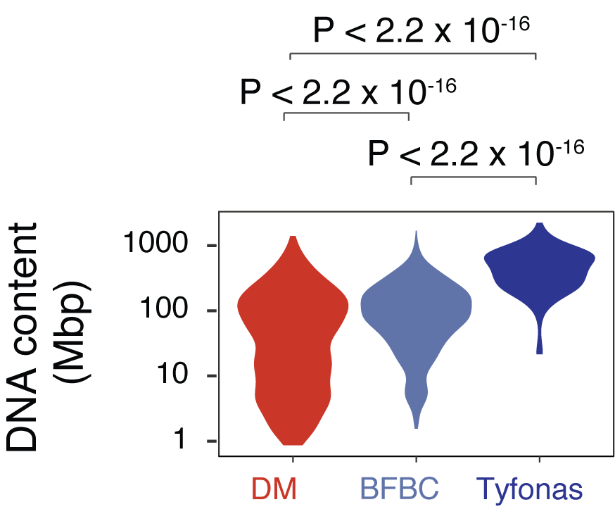
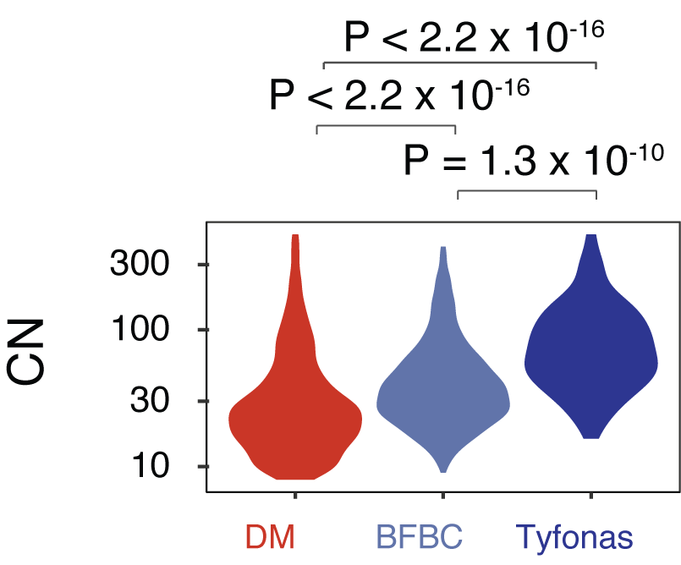
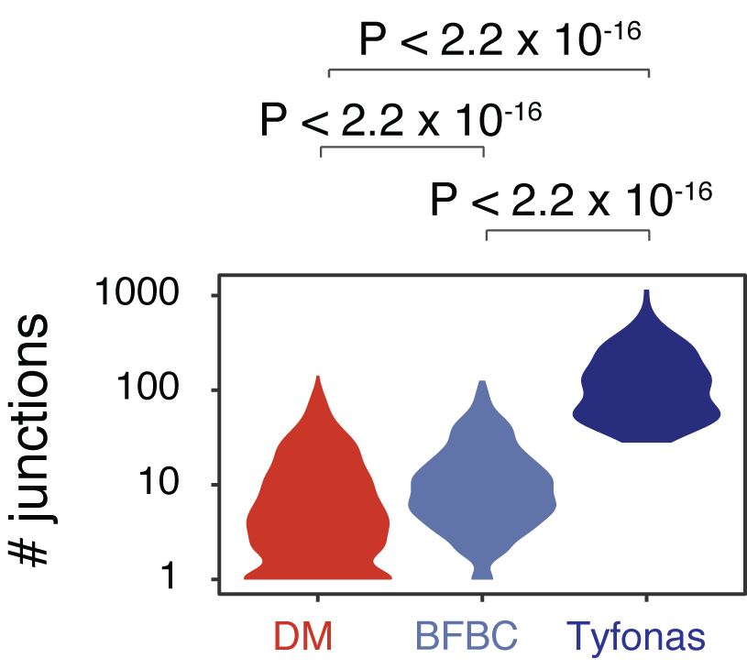
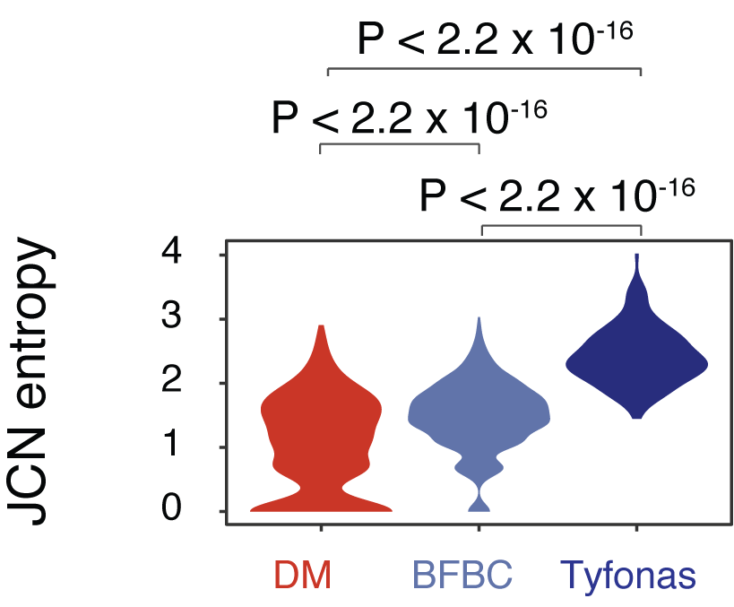
Tyfonas has higher CN, is heavier, more complex, and more heterogeneous in JCN
Hadi, K. et al. Cell 183, 197–210.e32 (2020)

Slide 35
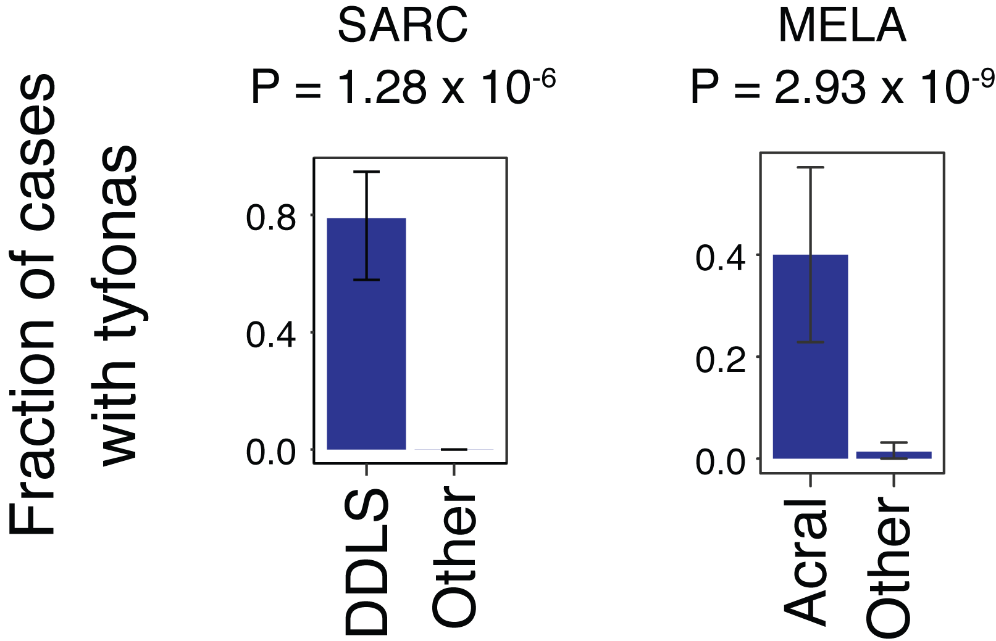
Tyfonas enrich in lipo- but not myosarcoma, acral- but not cutaneous melanoma
Hadi, K. et al. Cell 183, 197–210.e32 (2020)

Slide 36

Tyfonas create the most fusion genes
Hadi, K. et al. Cell 183, 197–210.e32 (2020)

Slide 37

Define 13 classes of simple to complex SVs
Hadi, K. et al. Cell 183, 197–210.e32 (2020)

Slide 38

Clustering pan-cancer cohort based on SV
Hadi, K. et al. Cell 183, 197–210.e32 (2020)

Slide 39

BR cluster associated with TP53 LOF DDT cluster associated with BRCA1 germline LOF
Hadi, K. et al. Cell 183, 197–210.e32 (2020)

Slide 40

Several clusters associated with worse overall survival than QUIET
Hadi, K. et al. Cell 183, 197–210.e32 (2020)

Slide 41
Conclusions
Tyfonas is a distinct class of amplicon with high junction content and JCN heterogeneity, amplifies larger DNA mass
Tyfonas enrich in liposarcoma and acral melanoma
Tyfonas create more expressed fusion genes than other events
Clustering pan-cancer patients with SVs reveal tissue specificity, association with genome maintenance defects, and worse OS

Slide 42
CHAPTER 4
Structural Variant Evolution After Telomere Crisis

Slide 43


Telomere shortening causes genome instability
Maciejowski, J. & de Lange, T. Nat. Rev. Mol. Cell Biol. 18, 175–186 (2017)

Slide 44

Maciejowski, J. & de Lange, T. Nat. Rev. Mol. Cell Biol. 18, 175–186 (2017)

Slide 45


Telomere crisis -> chromothripsis (?)
Maciejowski, J. et al. Nat. Genet. (2020) Maciejowski, J., Li, Y., Bosco, N., Campbell, P. J. & de Lange, T. Cell 163, 1641–1654 (2015)

Slide 46
Telomere crisis -> BFB (?)

Slide 47

Telomere crisis -> simple arm changes (?)
Cleal, K. et al. Genome Res. 29, 737–749 (2019)

Slide 48
What are the SV consequences of telomere crisis?
Profile existing cell line spontaneously escaped crisis
A new in vitro model of telomere crisis

Slide 49



Genome structures of existing post-crisis cell lines vary: some complex, some (surprisingly) quiet
9 cell lines that survived TC through TERT reactivation, along with their pre-TC/post-SV40T controls
Dewhurst, Yao, et al., 2020 (in review)

Slide 50

One instance of (early) BFB cycle (SW39)
Dewhurst, Yao, et al., 2020 (in review)

Slide 51

Complex amplicons hard to classify (BFT3B)
Dewhurst, Yao, et al., 2020 (in review)

Slide 52
An ideal in vitro model…
Reenacts the natural replicative attrition of telomeres
Previous models disable shelterin components (TRF2)
Keep the number of dicentric chromosomes low like in real tumorigenesis
Mimics the way cancer reactivates telomerase
Low expression, only enough to barely save the shortest telomeres
Accurately time the escaping & cloning
Not allowing too long extended instability period
Deconvolve from other repair deficiencies or existing damage
MRC5 diploid fibroblast
Other than Rb/p21 silencing, has intact repair pathways

Slide 53




iCRISPRa of telomerase in Rb/p21-deficient MRC5 fibroblasts

Slide 54

Telomerase activity increase in +dox

Slide 55

+dox group has overall shorter yet less critically short telomeres

Slide 56

+dox group show reduced chromosome fusions

Slide 57

+dox group show reduced DNA damage

Slide 58

+dox group shows reduced micronuclei

Slide 59

Screening for SVs with shallow WGS
Dewhurst, Yao, et al., 2020 (submitted)

Slide 60

6 groups of CNAs emerge
Dewhurst, Yao, et al., 2020 (submitted)

Slide 61

BFB-like cluster aggregated read depth

Slide 62


SV evolution in chr12 genome graphs

Slide 63



Convergent evolution on 12p resolved with deeper WGS
The BFB evolution happened relatively fast!
Dewhurst, Yao, et al., 2020 (submitted)

Slide 64


Distinct loose ends point to independent resolving events
Dewhurst, Yao, et al., 2020 (submitted)

Slide 65


Independent fusion to 21p concluded BFB cycles at different loci
Acrocentric, Repetitive (rDNA)
Can long read help reaffirm the fusion in the mist of repetitive sequences?
Dewhurst, Yao, et al., 2020 (submitted)

Slide 66

More evidence for fusion to chr21p to resolve BFB

Slide 67


Phasing chr12 with respect to Y11 (arm loss)

Slide 68


A single chr12p allele with short telomere triggers the events

Slide 70




Special thanks to my mentor:
Marcin Imielinski
http://github.com/mskilab www.mskilab.org
Marcin Imielinski Lab
Marcin Imielinski, MD, PhD (PI)
Julie Behr (Tri-I CBM PhD student)
Kevin Hadi (WCM PBSB PhD student)
Aditya Deshpande (Tri-I CBM PhD student)
Huasong Tian (research scientist)
Kofi Gyan (Tri-I CBM PhD student)
Alon Shaiber (genomics data scientist)
Charalampos Xanthopoulakis (soft eng)
Yajas Shah (WCM PBSB PhD student)
Zi-ning Choo (WCM MD-PhD student)
Alumni
Netha Ulahanna (Postdoc)
Joel Rosiene (medical student)
Alon Millet (CBM)
Madison Darmofal (CBM)
Joe DeRose (Undergrad)
Emily Adeny (Postdoc)
Rick Mortensen (Undergrad)
Zoran Gajic (Undergrad)
Notes:
Topography: enriched in SINE, depleted in LINE, enriched around enhancers, depleted in heterochromatin, early replicating, and enriched in highly transcribed regions

Slide 71
And our many awesome collaborators
Talkowski Lab
Michael Talkowski
Ryan Collins
Xuefang Zhao
De Lange Lab@RU
Titia de Lange
Sally Dewhurst, PhD (Postdoc)
TCGA Genomic Data Analysis Network
Matthew Meyerson (DFCI)
Ramaswamy Govindan (WUSTL)
Jian Carrot-Zhang (DFCI)
Siddhartha Devarakonda (WUSTL)
Molecular Biology
Radiation Oncology
Department of Pathology
Memorial Sloan Kettering Cancer Center
Simon Powell
Jorge Reis-Filho
Nadeem Riaz
Jeremy Setton
John Maciejowski
Englander Institute for Precision Medicine
Department of Pathology & Laboratory Medicine
Weill Cornell Medicine
Olivier Elemento
Juan Miguel Mosquera
Andrea Sboner
David Wilkes
Sarah Kudman
Kenneth Eng
Michael Sigouros
New York Genome Center
Computational Biology Group
Michael Zody
Nicholas Robine
Kazimierz Wrzeszczynski (and Cancer Alliance)
Jennifer Shelton
Minita Shah
William Hooper
Kanika Arora
Reid lab @ Fred Hutchinson Cancer Center
Brian Reid
Patricia Gaulipeau
Xiaohong Li
Thomas Paulson
Lucia Smith
Kenji Oman
Carissa Sanchez
Mary Kuhner
And my PhD program
Tri-I CBM
Christina Leslie
Ekta Khurana
Haiyuan Yu
Kathleen Pickering
Margie Hinonangan-Mendoza

